Slide 1
Guideline for Machine Learning Projects
Naveen Kumar
Department of Computer Science
University of Delhi - 110007

Slide 2
Acknowledgement
Andrew Ng: Machine Learning Yearning: Technical Strategy for AI Engineers in the Era of Deep Learning
Coursera: Andrew Ng’s Deep Learning course
Tom Mitchell: Machine learning
Mayor, Adrienne, Gods and Robots, Princeton University Press.

Slide 3
The myths gave expressions to the timeless impulse to create artificial life*
Beings that were made, not born
Jason and the Argonauts, the bronze robot Talos, the techno-witch Medea, the genius craftsman Daedalus, the fire-bringer Prometheus, and Pandora, the evil bot created by Hephaestus, the god of invention.
Greek poets Hesiod and Homer (750-650 BCE): Reinforced the notion that imagination is the spirit that unites myth and science.
Medieval craftsman: Automatic moving Machines
*Mayor, Adrienne. Gods and Robots, Princeton University Press. Kindle Edition.

Slide 4
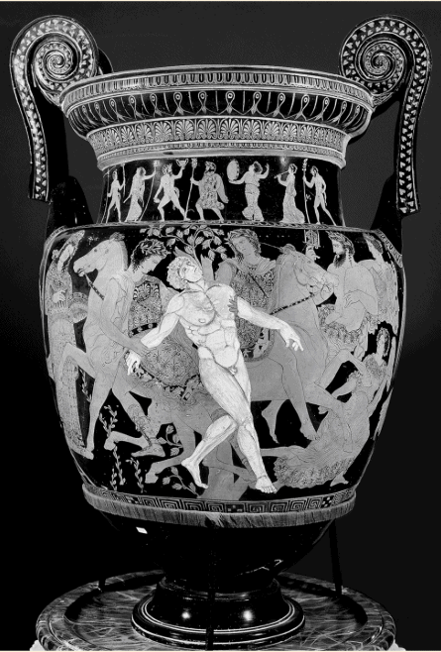

Slide 5
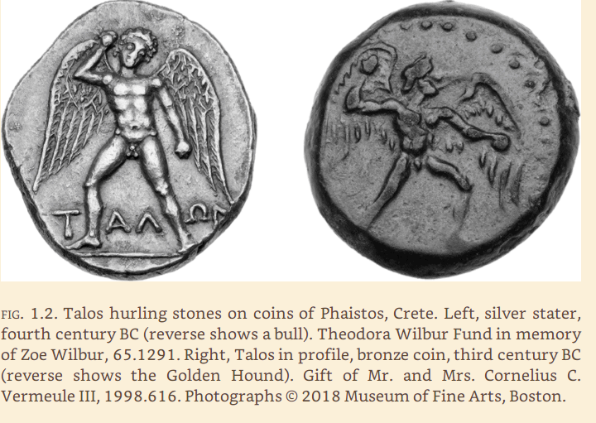

Slide 6
Machine Learning/Deep learning
1943, McCulloch: Model for neurons in brain
1959, Widrow & Hoff of Stanford: ADALINE & MADALINE
1975, Werbos backpropagation algorithm
1982, Kohonen: Self Organizing Maps
1986, Rumelhnrt, Hinton, & Williams: Learning representations by backpropagation
1986, Rumelhart and McClelland parallel distributed processing:
Maxpooling, Convolution networks, Sequential Networks
Notes:
ADALINE: Adaptive linear element
Multiple adaptive linear element
2011: the state of the art in deep learning feedforward network

Slide 7
Courses in Machine Learning/Deep Learning
Machine Learning https://www.coursera.org/learn/machine-learning
Master of Machine Learning & Data Science https://www.coursera.org/degrees/msc-machine-learning-imperial
Neural Networks and Deep Learning (https://www.coursera.org/learn/neural-networks-deep-learning)
Deep Learning Specialization (https://www.coursera.org/specializations/deep-learning)
Deep Learning for Business (https://www.coursera.org/learn/deep-learning-business)
Deep Learning (https://in.udacity.com/course/deep-learning--ud730)
Deep Learning A-Z™: Hands-On Artificial Neural Networks (https://www.udemy.com/deeplearning/)

Slide 8
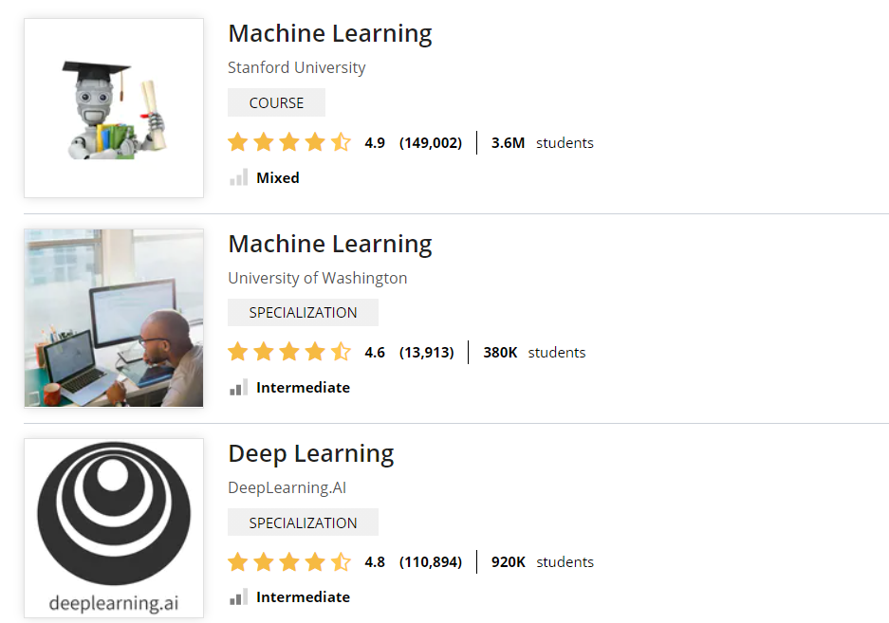
Coursera.org

Slide 9
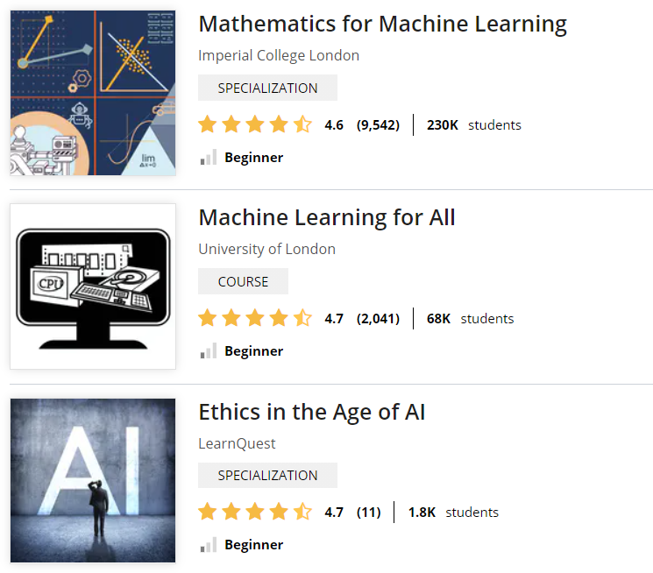

Slide 10
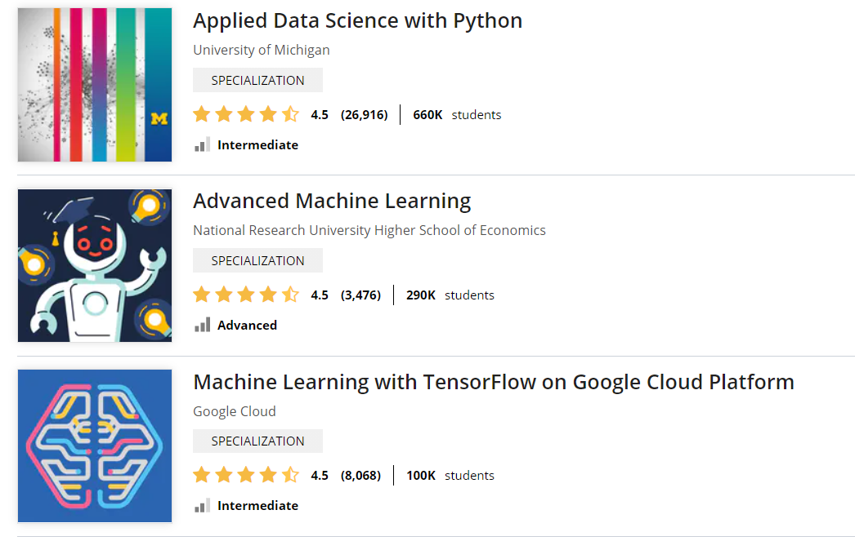

Slide 11


Slide 12
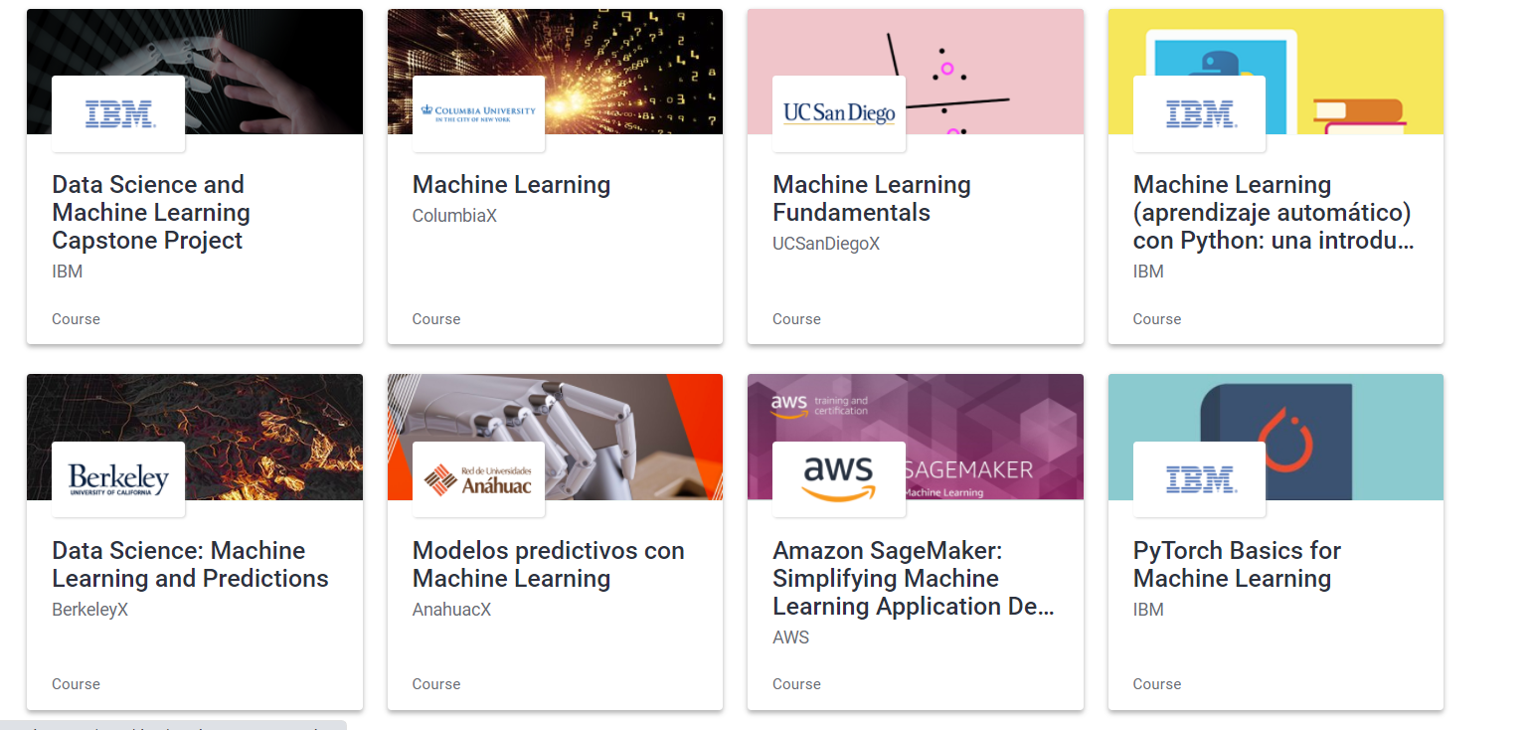

Slide 13


Slide 14
Turing Awards

Slide 15
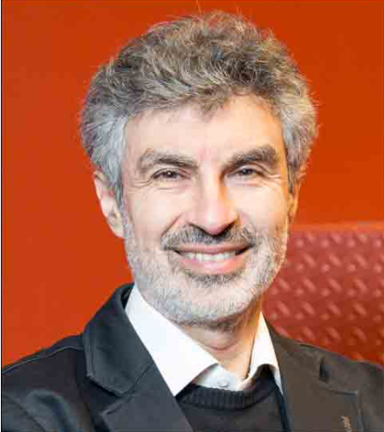
2018: Machine Learning Recognized ACM Turing Award Conferred on Pioneers in ML/DL Yoshua Bengio: University of Montreal

Slide 16
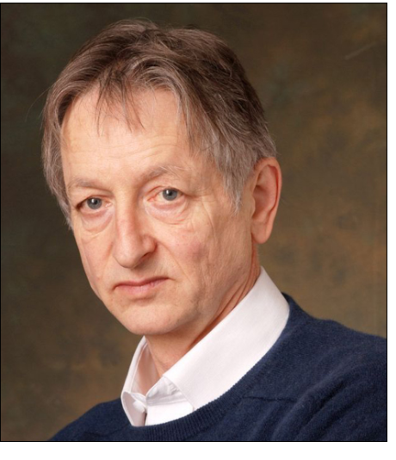
Geoffrey Hinton: Univ. of Toronto

Slide 17
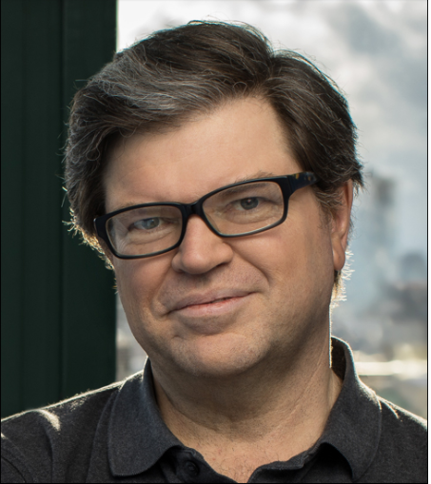
Yann LeCun: CIMS

Slide 18
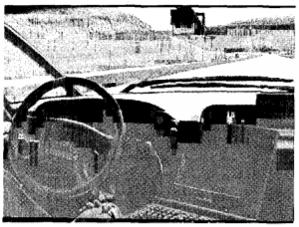
ALVINN
Notes:
Neural network learning to steer an autonomous vehicle based on five minutes of human driving on the highway. The ALVINN system uses BACKPROPAGATION to learn to steer an autonomous vehicle (photo in previous slide) driving at speeds up to 70 miles per hour.
ALVINN: An Autonomous Land Vehicle in a Neural Network

Slide 19
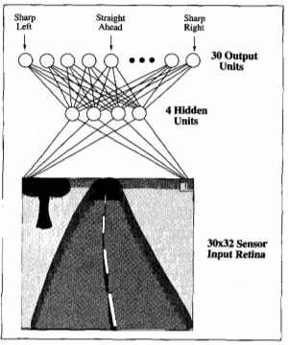
ALVINN ( Pomerleau: ‎1989)
Notes:
The diagram shows how the image of a forward-mounted camera is mapped to 30X32=960 neural network inputs, which h are fed forward to 4 hidden units, connected to 30 output units. Network outputs encode the commanded steering direction.

Slide 20
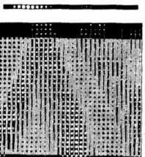
ALVINN
Notes:
The figure shows weight values for one of the hidden units in this network. The 30 x 32 weights into the hidden unit are displayed in the large matrix, with white blocks indicating positive and black indicating negative weights. The weights from this hidden unit to the 30 output units are depicted by the smaller rectangular block directly above the large block. As can be seen from these output weights, activation of this hidden unit encourages a turn toward the left.

Slide 21
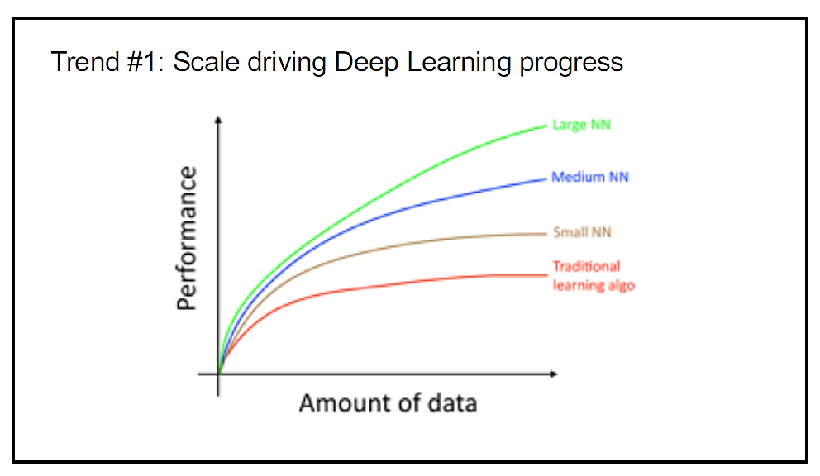
Scale Drives ML/DL
Driving Factors:
Scale of Data –Lot of data with complex problem to solve
Size of Network – A lot of hidden layers with a lot of parameters and a lot of connections
Notes:
Small Training Sets:
performance depends on the individual skills to extract features and apply algorithms
Focus drift: on algorithms, e.g, from sigmoid function to ReLu
Sigmoid fn: There is a region where gradient becomes nearly zero, and the convergence becomes really slow

Slide 22
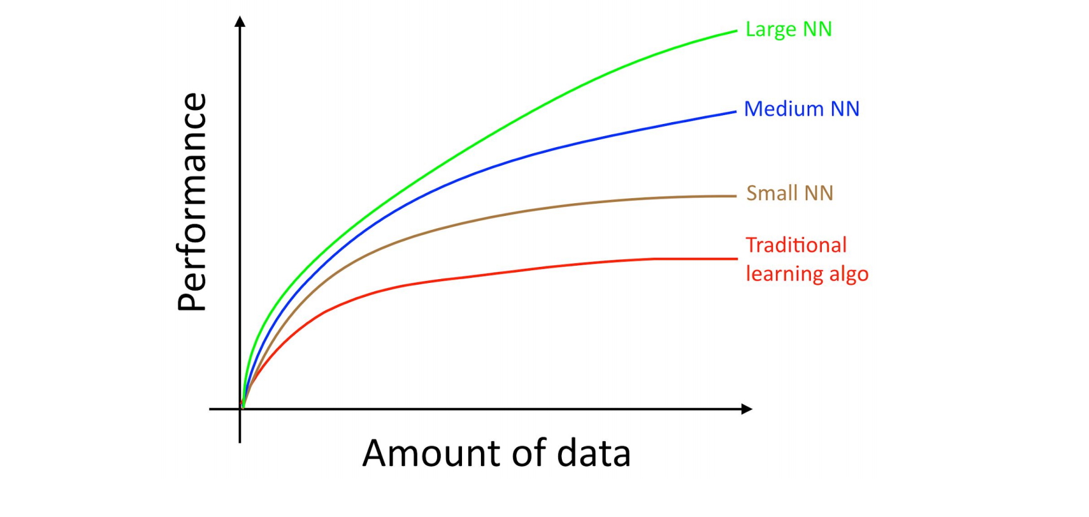
Scale Impacts Learning

Slide 23
Setting up Data Sets
Training set : Initial learning
Development (dev) set/ hold out cross-validation set
Used for Parameter tuning
Test set: Evaluate performance
Data Distribution
Dev and Test datasets must come from the same distributions
Choose dev and test sets to reflect data you expect to get in the future and want to do well on

Slide 24
Setting up Data Sets: Mobile App Cat vs Non-cat
Not yet launched your mobile app
Do not have any users yet
Unable to get data that accurately reflects what you have to do well on in the future

Slide 25
Setting up Data Sets: Think Hard
Try to approximate real-life scenario
Ask your friends to take mobile phone pictures of cats and send them to you.
Once your app is launched, update your dev/test sets using actual user data

Slide 26
Classifier Accuracy
Classifier A: 90% accuracy
Classifier B: 90.1% accuracy
Do we need to distinguish between the two classifiers
Notes:
Size 100: will not be able to distinguish between the two classifiers

Slide 27
Size of dev/test sets
Classifier A: 90% accuracy
Classifier B: 90.1% accuracy
Do we need to distinguish between the two classifiers
Depends on application
Web search, recommendation system: 0.01% improvement matters
If yes, what what should be Dev set: 100? 1,000? 10,000? More?
How should training/dev/test datasets be distributed?
Notes:
Size 100: will not be able to distinguish between the two classifiers

Slide 28
Size of dev/test sets
Classifier A: 90% accuracy
Classifier B: 90.1% accuracy
Do we need to distinguish between the two classifiers
Depends on application
Web search, recommendation system: 0.01% improvement matters
If yes, what should be Dev set: 100? 1,000? 10,000? More?
How should training/dev/test datasets be distributed?
Historically (Small data sets) : 70%, 20%, 10%
Currently (Many applications have M size data sets): 98%, 1%, 1% or 99% 0.5% 0.5%
Notes:
Size 100: will not be able to distinguish between the two classifiers

Slide 29
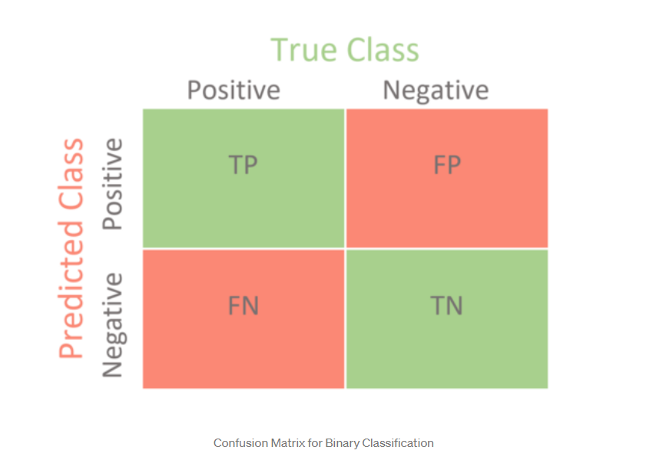
Evaluating Classifiers
Source: https://towardsdatascience.com/confusion-matrix-for-your-multi-class-machine-learning-model-ff9aa3bf7826

Slide 30
Evaluating Classifiers
Recall (Sensitivity): TP/(TP+FN)
True Positives/All Positives
Specificity: TN/ (TN+FP)
True Negatives/All Negatives
Precision: TP/(TP + FP)
True Positives/Reported Positive
Accuracy: (TP+ TN)/(TP+FP+TN+FN)
Classifier | Precision | Recall
A | 95% | 90%
B | 98% | 85%

Slide 31
Single-number evaluation metric
F1 Score | Precision | Recall | F1 Score
A | 95% | 90% | 92.4%
B | 98% | 85% | 91%
Use some kind of averaging operator

Slide 32
Single-number evaluation metric
Suppose you are separately tracking the accuracy of your cat classifier in four key markets:
(i) US, (ii) China, (iii) India, and (iv) Other.
This gives four metrics.
Consider: an average or weighted average

Slide 33
Optimizing and Satisficing Metrics
Accuracy Vs Running time
Classifier | Accuracy | Running time
A | 95% | 80ms
B | 97% | 90ms
C | 99% | 2,000ms
Notes:
Accuracy and Running-time are not equally important

Slide 34
Build First System Quickly, Iterate
Email anti-spam system
Collect a huge training set of spam email (honeyspot)
Develop features for understanding the text content of the email
Develop features for understanding the email header features
...

Slide 35
Mobile App: Cat vs Non-Cat
Observation: 90% accuracy, app mistakes dogs for cats
What to do?
Get a sample of 100 misclassified dev examples
Count what fraction of these are dogs
Finding: 5% of misclassified images are dogs
Q: Do we incorporate a tool that works well on dogs
Best expected?
All misclassified dogs marked Non-cat
On a sample of 100, there are 10 errors
Out of all errors, 5% are dogs classified as cats
Improvement: 5% of 10 i.e. 0.5, Accuracy moves up 90% to 90.5%
Notes:
5% Dog images: Improvement: 5% of 10% (misclassified images) i.e.0.5%.
50% dog images: improvement: 50% of 10% i.e. 5%

Slide 36
Cleaning up Mislabelled Dev/Test Set Examples
Overall accuracy: 90% (10% overall errors)
Mislabelled data: 6%
Should we correct the labels in the dev set?

Slide 37
Cleaning up Mislabelled Dev/Test Set Examples
Overall accuracy: 90% (10% overall errors)
Mislabelled data: 6%
Should we correct the labels in the dev set?
Errors due to mislabelled examples: 0.6 (6% of 10)
Errors due to other causes: 9.4 (94% of dev set errors)

Slide 38
Cleaning up Mislabelled Dev/Test Set Examples
Overall accuracy: 98% (2% overall errors)
Errors due to mislabelled examples:
0.6% out of overall 2%
% of dev set errors caused by mislabelled examples:
(0.6/2)*100 = 30%
Errors due to other causes: 1.4% (70% of dev set errors)
Q: Should we correct the mislabelled examples?

Slide 39
Cleaning up Mislabelled Dev/Test Set Examples
Overall accuracy: 98% (2% overall errors)
Errors due to mislabelled examples:
0.6% out of overall 2%
% of dev set errors caused by mislabelled examples:
(0.6/2)*100) = 30%)
Errors due to other causes: 1.4% (70% of dev set errors)
Q: Should we correct the mislabelled examples?

Slide 40
Cleaning up Mislabelled Dev/Test Set Examples
Overall accuracy: 98% (2% overall errors)
Errors due to mislabelled examples:
0.6% out of overall 2%
% of dev set errors caused by mislabelled examples:
(0.6/2)*100 = 30%
Errors due to other causes: 1.4% (70% of dev set errors)
Q: Should we correct the mislabelled examples?
Whatever process you apply to fixing dev set labels, remember to apply it to the test set labels too so that dev and test sets continue to be drawn from the same distribution

Slide 41
Cleaning up Mislabelled Dev/Test Set Examples
What about labels of examples that system correctly classified?
Do we need to need to examine these?

Slide 42
Cleaning up Mislabelled Dev/Test Set Examples
What about labels of examples that system correctly classified?
Do we need to need to examine these?
Both the original label and the one generated by the learning algorithm could be wrong on an example.
If you fix only the labels of examples that your system had misclassified, you might introduce bias into your evaluation.

Slide 43
Eyeball Dev set vs Blackbox Dev Set
Dev set: 5,000 examples
Error rate: 20% (1,000 examples)
Size of eyeball dev set

Slide 44
Eyeball Dev set vs Blackbox Dev Set
Dev set: 5,000 examples
Error rate: 20% (1,000 examples)
Size of eyeball dev set
~50 errors: good sense of error sources
~100 errors: very good sense of error sources
Manually examine: 100 errors (10% of errors )

Slide 45
Eyeball Dev set vs Blackbox Dev Set
Dev set: 5,000 examples
Error rate: 20% (1,000 examples)
Size of eyeball dev set
~50 errors: good sense of error sources
~100 errors: very good sense of error sources
Manually examine: 100 errors (10% of errors )
Split Dev Set
Eyeball dev set: 500 examples (10% of 5,000)
Blackbox dev set: remaining 4,500 examples

Slide 46
How big should the Eyeball and Blackbox dev sets be?
Error rate: 5%
Looking for ~100 errors

Slide 47
How big should the Eyeball and Blackbox dev sets be?
Error rate: 5%
Looking for ~100 errors
N*5/100 = 100
N = 2,000

Slide 48
How big should the Eyeball and Blackbox dev sets be?
Error rate: 5%
Looking for ~100 errors
N*5/100 = 100
N = 2,000
Conclusion:
The lower your classifier’s error rate, the larger your Eyeball dev set needs to be in order to get a large enough set of errors to analyze.

Slide 49
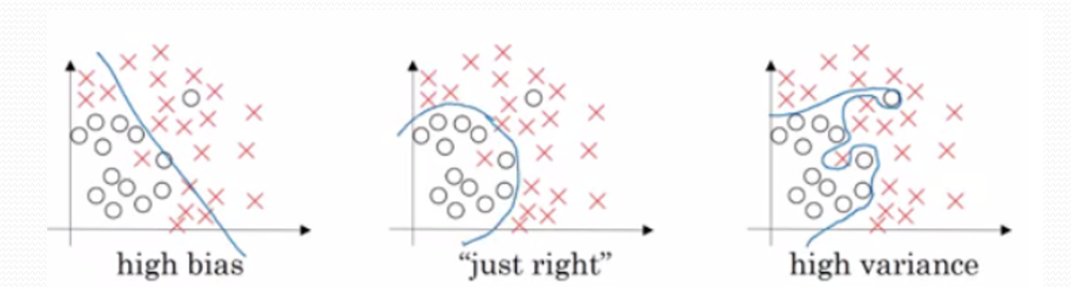
Bias/Variance

Slide 50
Bias and Variance
Objective: Cat recognizer with 95% accuracy
Training set error: 15%
Dev set error: 16%
Bias: 15%
Variance: 1%
What to do?

Slide 51
Bias and Variance
Objective: Cat recognizer with 95% accuracy
Training set error: 15%
Dev set error: 16%
Bias: 15%
Variance: 1%
What to do?
Fine-tune hyperparameters?
Increase model complexity?
Modify input features?
Reduce regularization?
Increase size of dataset?
Do nothing?

Slide 52
Comparing to Optimal Error Rate
Ideal error rate: Optimal classifier (Human Error)
Cat classification problem: 0%
Speech recognition: May be 14% clips too noisy
Optimal error rate (unavoidable bias or Bayes rate): 14%
Avoidable bias: 1%
Bias = unavoidable bias + avoidable bias
Human performance not good on all tasks

Slide 53
Surpassing Human-level Performance
Predicting movie ratings
how long it will take to drive somewhere
Whether to approve a loan application

Slide 54
Bias and Variance
Bias: Error rate on your training set
Variance: Gap between performance on the test set vis a vis training set
 | A | B | C | D
Training Error % | 1 | 15 | 15 | 0.5
Dev Error% | 11 | 16 | 30 | 1

Slide 55
Addressing Bias/Variance
High avoidable bias
Increase the size of your model
Try different architecture
Modify input features
Reduce regularization
Typically doesn’t work: Add more training data

Slide 56
Addressing Bias/Variance
High variance
Add data to your training set
Apply regularization (L2, L1, drop out)
Early stopping
Feature selection to decrease number of input features significantly
Decrease the model size
Modify input features based on insights from error analysis
Modify model architecture (Prefer simpler architecture)

Slide 57
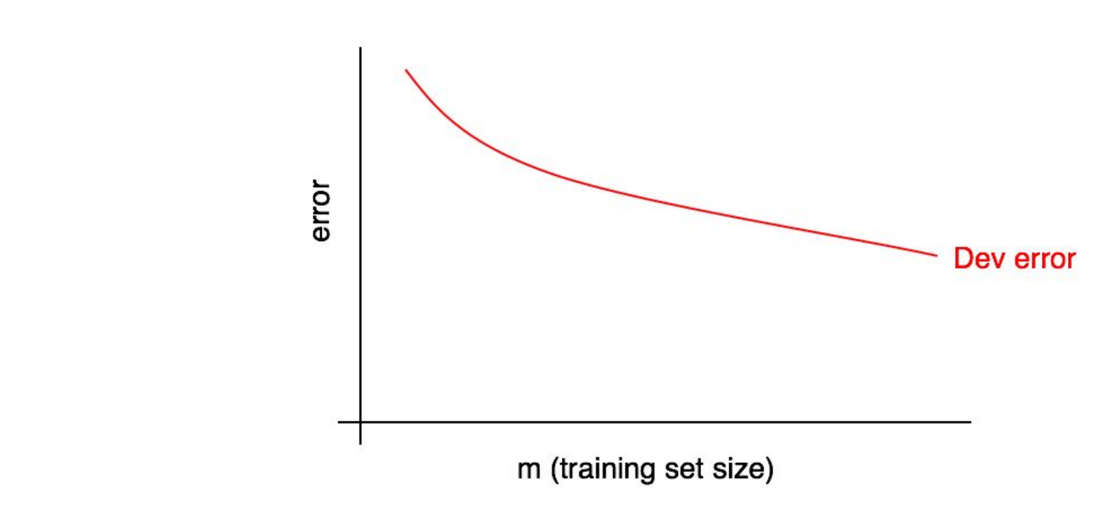
Learning curves: Diagnosing bias and variance
Desired Error rate:
Human Level Performance
Acceptability to user

Slide 58
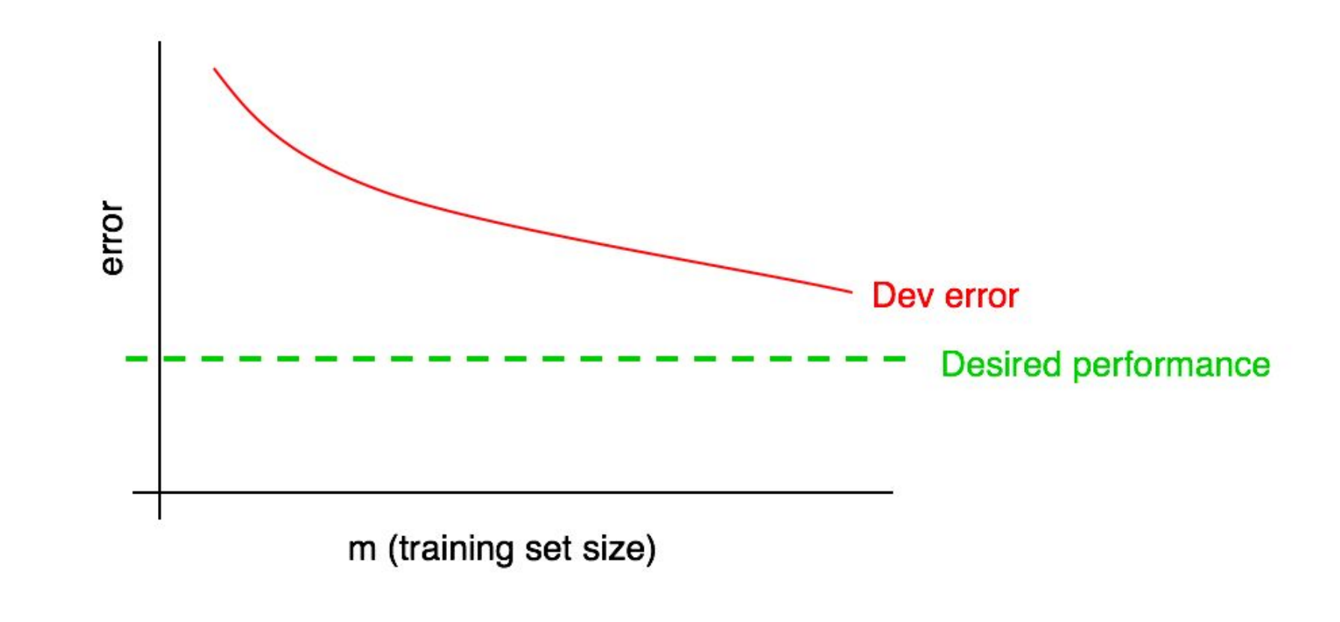
Desired Performance on Dev set
Will increasing the training set size help?

Slide 59
Desired Performance on Dev set
If yes, how much data should we add?

Slide 60
Desired Performance on Dev set
Extrapolate the curve to the desired level.
Doubling the data should do the needful.

Slide 61
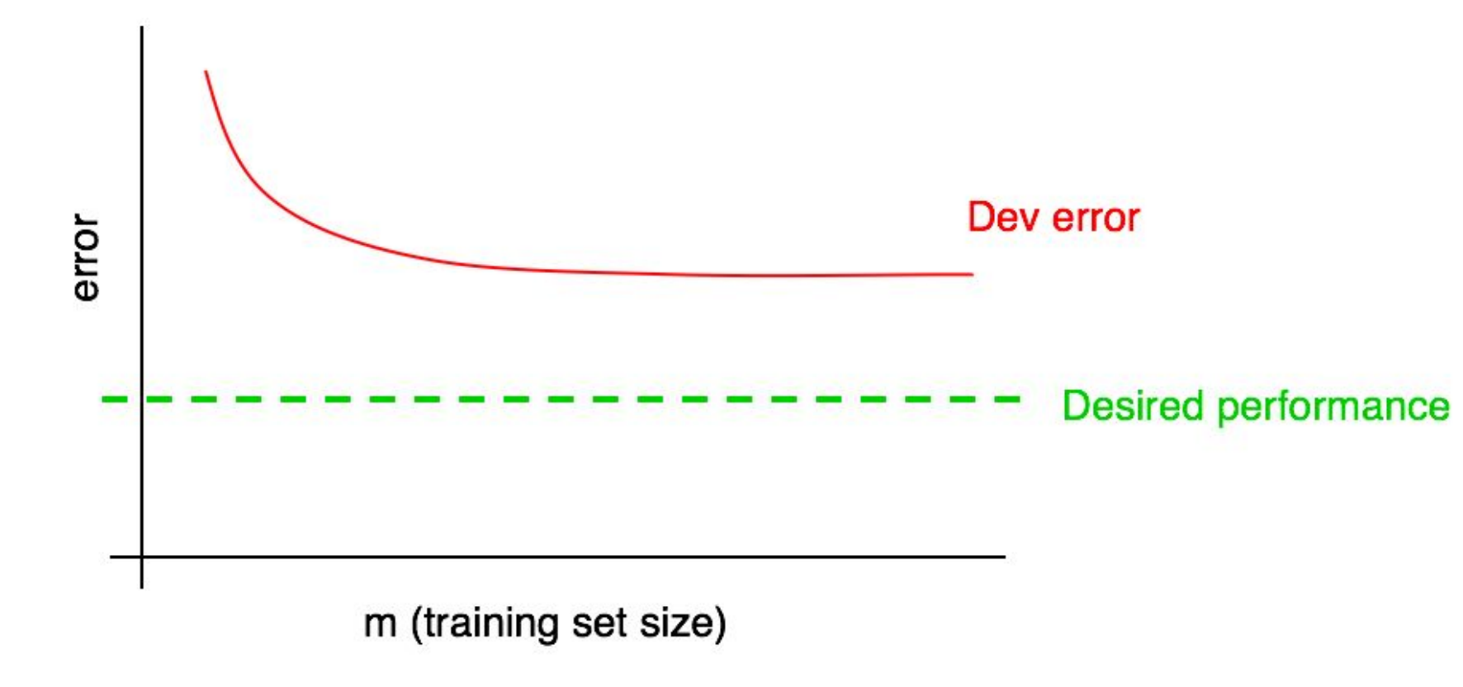
Flattened Dev error Curve
Will increasing the training set size help?

Slide 62
Flattened Dev error Curve
Increasing the training set size won’t get you closer to the goal.

Slide 63
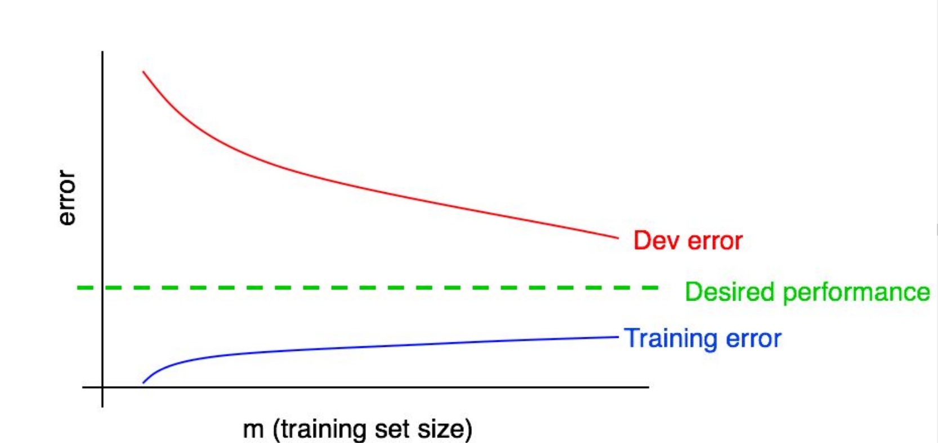
Desired Performance: Role of Training Curve
Why might the training error increase fast initially?

Slide 64
Desired Performance: Role of Training Curve
Too small training error size: memorizes correctly
Training error increases because Neural Network cannot memorize any more

Slide 65
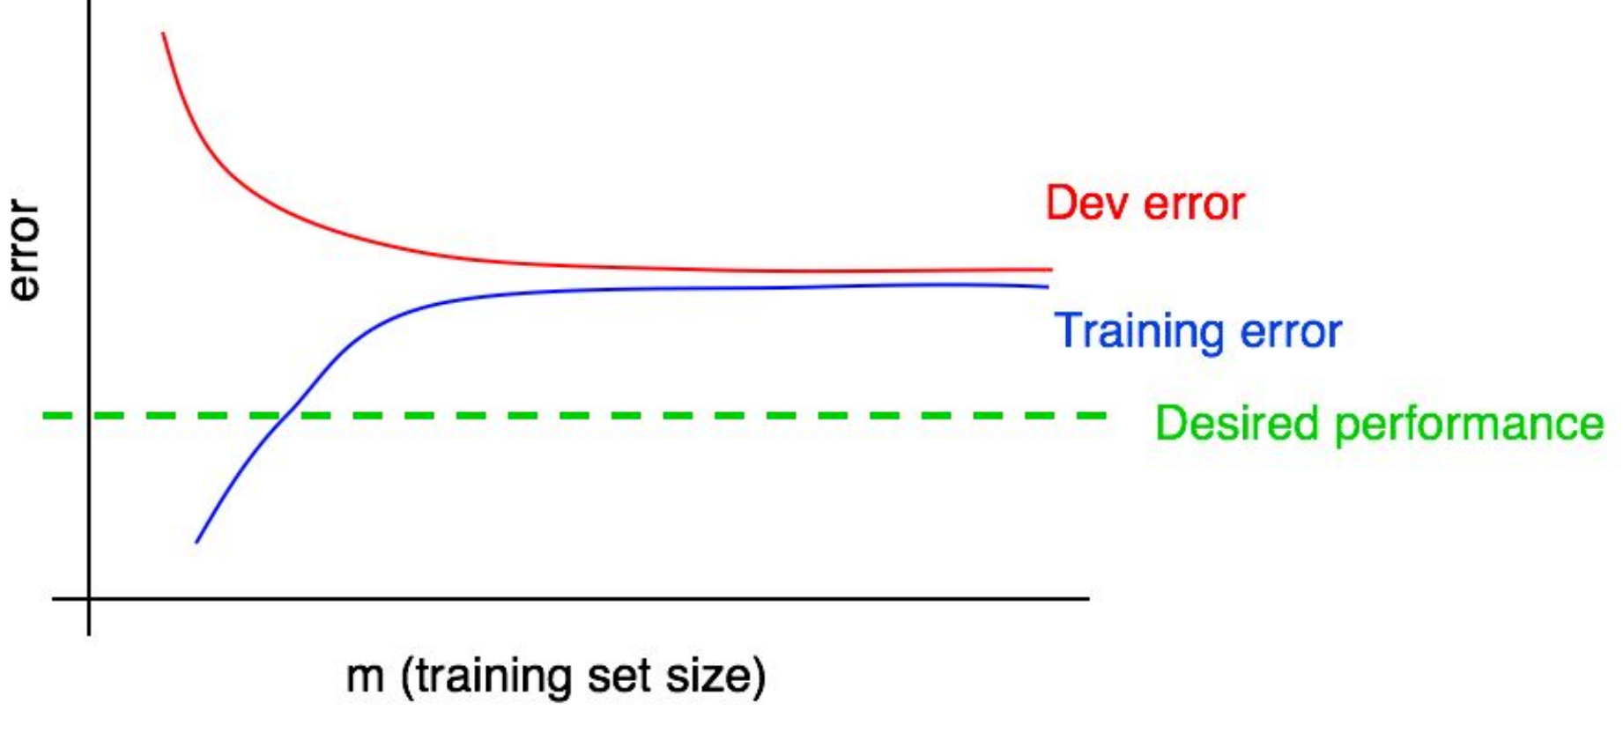
Will increasing the training set size help?

Slide 66
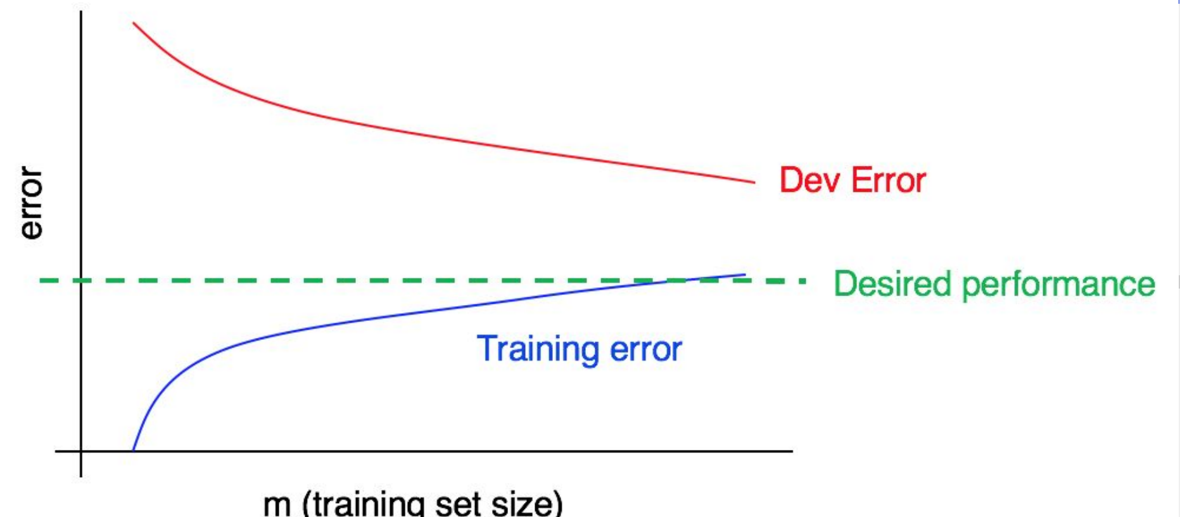

Slide 67
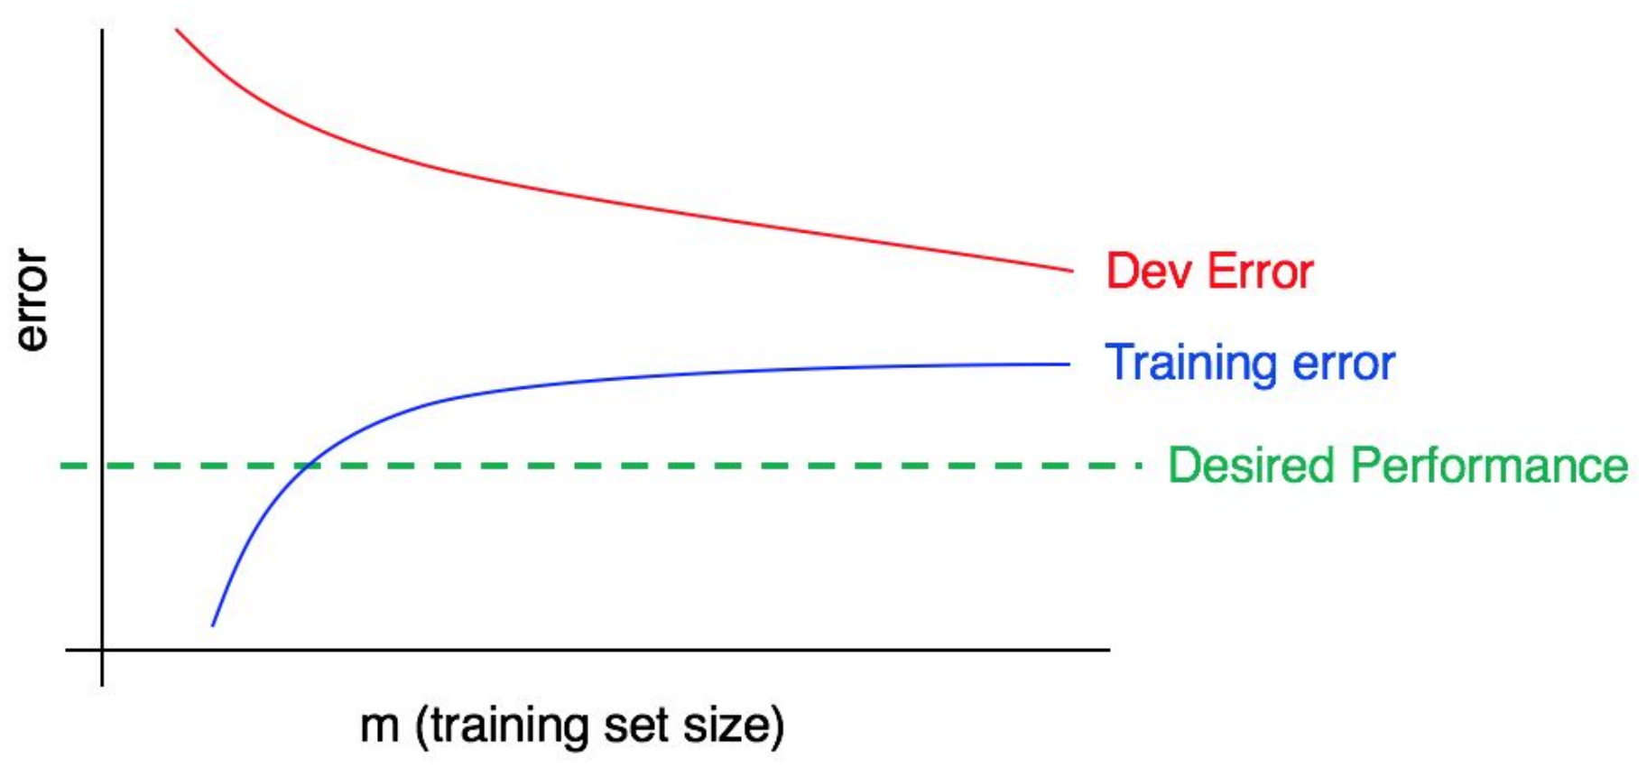
High Bias & High Variance
Should we increase the size of training data?

Slide 68
High Bias & High Variance

Slide 69
High Bias & High Variance
Adding more training data, training error can only get worse
There’s almost no way that adding more data would allow the red dev error curve to drop down to the desired level of performance when even the training error is higher than the desired level

Slide 70
Thank you Questions

Slide 71
Regularization
Objective: To improve generalization of our model on unseen data
How it works: Constrains our optimization problem to discourage complex models

Slide 72
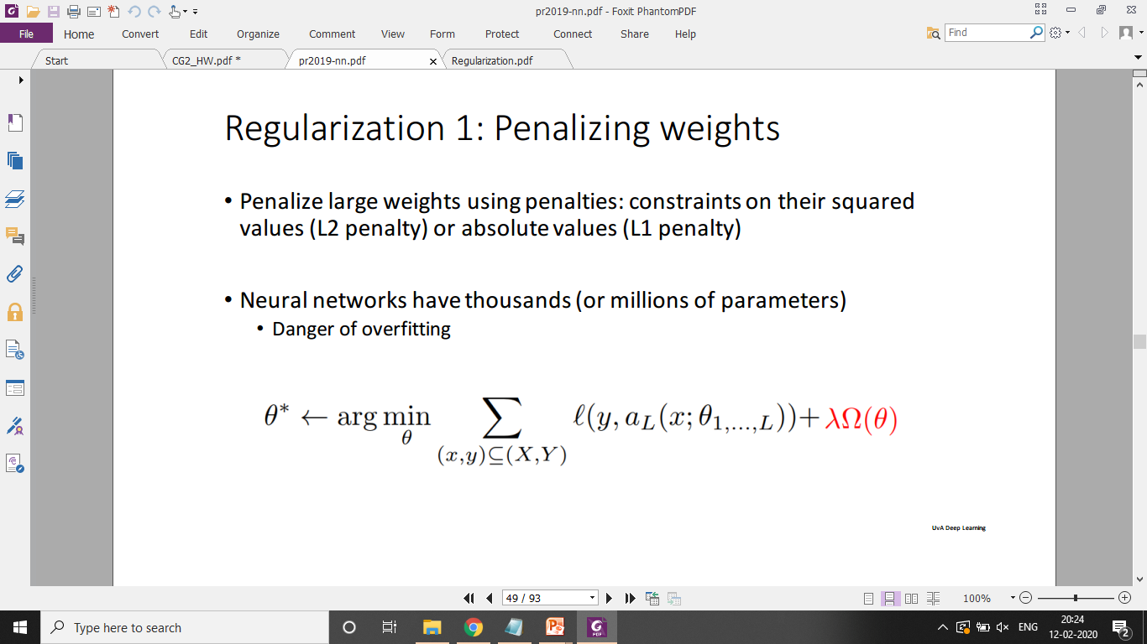

Slide 73
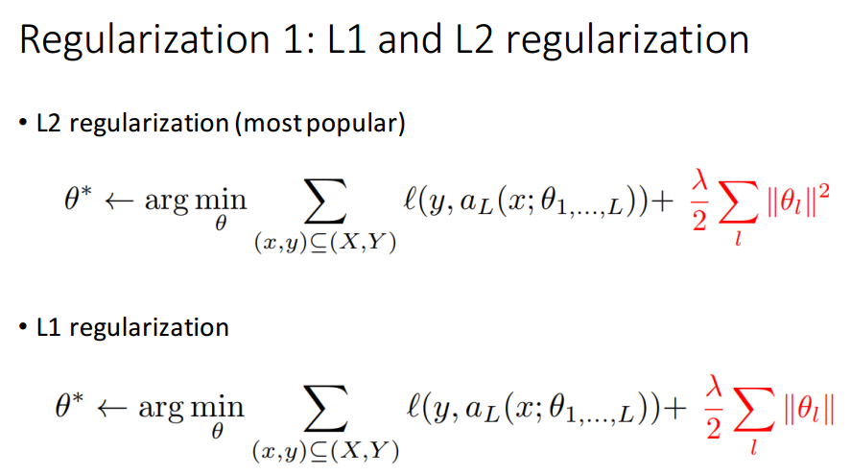

Slide 74
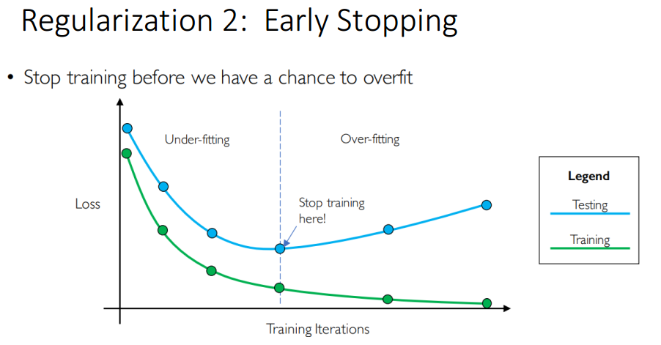

Slide 75
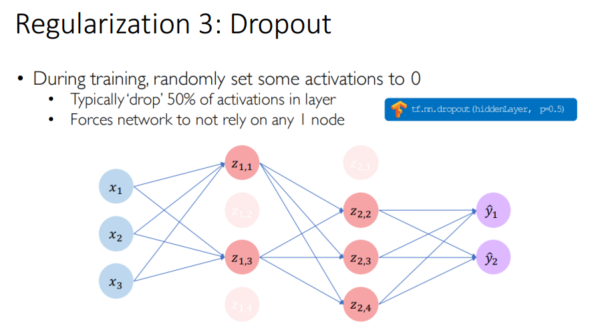

Slide 76
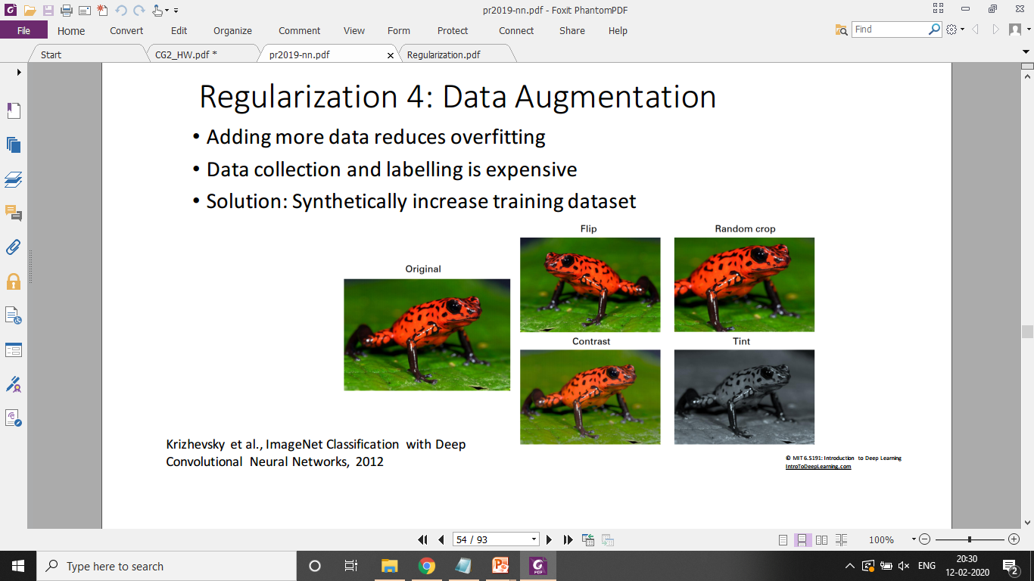

Slide 77
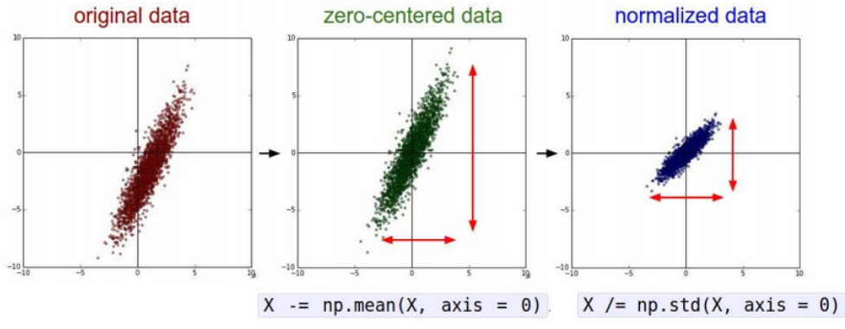
Normalizing inputs
Normalized inputs helps for the learning process
Subtract mean and normalize variances
Use the same mean and variance to normalize the test (you want them to go through the same transitions)

Slide 78
Small Data Size: Learning Curve Related Issues
Learning curve could be noisy
small training set
ambiguous/mislabelled examples
Training set skewed towards one class

Slide 79
Learning Curves: Related Issues
Solution
Train models on different training sets
Compute and plot average training and dev error
Choose a balanced subset instead of purely random
Training different models may be computationally expensive
Avoid increasing training size linearly
with 10,000 training examples, try training sizes of 1000, 2000, 4000, 6000, 10,000

Slide 80
Training and Testing on Different Distributions may be a Good Idea
Available data (cat/non-cat):
200,000 images from the Internet
10,000 images uploaded by users
How to choose training/dev/test data sets?

Slide 81
Is Training and Testing on Different Distributions a Good Idea?
Available data (cat/non-cat):
200,000 images from the Internet
10,000 images uploaded by users
Randomly picking training/dev/test data sets from 210,000 examples violates the basic principle:
Choose dev and test sets to reflect data you expect to get in the future and want to do well on.

Slide 82
Training and Testing on Different Distributions may be a Good Idea
Available data (cat/non-cat):
200,000 images from the Internet
10,000 images uploaded by users
Randomly picking training/dev/test data sets from 210,000 examples violates the basic principle:
Choose dev and test sets to reflect data you expect to get in the future and want to do well on.
Distribute user images:
Training: 5,000
Dev/test: 5,000

Slide 83
Training and Testing on Different Distributions may be a Good Idea
Available data (cat/non-cat):
200,000 images from the Internet
10,000 images uploaded by users
Randomly picking training/dev/test data sets from 210,000 examples violates the basic principle:
Choose dev and test sets to reflect data you expect to get in the future and want to do well on.
Distribute user images:
Training: 5,000
Dev/test: 5,000

Slide 84
Speech Recognition Example
20,000 examples of street addresses
500,000 examples of other audio clips with users speaking about other topics.
Training set: Include: 10,000 examples of street addresses
Dev/Test Set: include 10,000 examples of street addresses

Slide 85
Is Training and Testing on Different Distributions a Good Idea
Predicting House Prices in different cities
Delhi
Udaipur
Do we merge the two data sets?

Slide 86
Training and Testing on Different Distributions may be a Bad Idea
Predicting House Prices in different cities
Delhi
Udaipur
Do we merge the two data sets?
Difference between the nature of two problems
prediction of house prices
prediction of cat/non-cat

Slide 87
Training and Testing on Different Distributions may be a Bad Idea
Cat/Non-cat: given an input picture x, one can reliably predict the label y indicating whether there is a cat, even without knowing if the image is an internet image
Price of a house: Without knowing the location, one cannot predict the price of a house

Slide 88
If Training and Testing on Different Distributions is a Bad Idea, can be made a better Idea
Price of a house: Can we make the situations somewhat similar Cat/Non-cat so that we can use the entire dataset

Slide 89
Training and Testing on Different Distributions may be a Bad Idea
Price of a house: Can we make the situations somewhat similar Cat/Non-cat so that we can use the entire dataset
Consider additional attribute: city

Slide 90
How to decide whether to use all your data
Available data (cat/non-cat):
20,000 images from the Internet
10,000 images uploaded by users
Early Generation ML Algorithms
Handcrafted features
Internet Image inclusion: Real risk of performing worse
Large NNs: Performance likely to improve
More examples of what cats do/do not look like
NN can apply some of the knowledge acquired from internet images to mobile app images.

Slide 91
How to decide whether to use all your data
It forces the NN to expend some of its capacity to learn about properties that are specific to internet images
Examples: higher resolution, different distributions of how the images are framed, etc.
These properties may differ greatly from mobile app images, if so
It will “use up” some of the representational capacity of the neural network
There is less capacity for recognizing data drawn from the distribution of mobile app images.

Slide 92
How to decide whether to use all your data
Sherlock Holmes Quote
Your brain is like an attic; it only has a finite amount of space.
“for every addition of knowledge, you forget something that you knew before. It is of the highest importance, therefore, not to have useless facts elbowing out the useful ones.”

Slide 93
Sherlock Holmes: May not be the last word

Slide 94
Sherlock Holmes: May not be the last word
If you have the computational capacity needed to build a big enough neural network—i.e., a big enough attic—then this is not a serious concern.

Slide 95
Sherlock Holmes: May not be the last word
If you have the computational capacity needed to build a big enough neural network—i.e., a big enough attic—then this is not a serious concern.
You have enough capacity to learn from both internet and from mobile app images, without the two types of data competing for capacity.
Your algorithm’s “brain” is big enough that you don’t have to worry about running out of attic space.

Slide 96
Sherlock Holmes: Serious Advice
If you do not have a big enough neural network (or another highly flexible learning algorithm), then you should pay more attention to your training data matching your dev/test set distribution.
You may not have sufficient computational resources

Slide 97
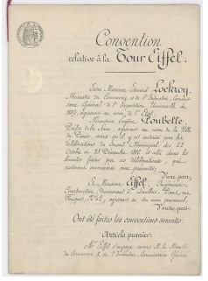
Cat/Non-cat: Data Unlikely to contribute to learning

Slide 98
Cat/Non-cat: Data Unlikely to contribute to learning
These documents don’t contain anything resembling a cat.
They also look completely unlike your dev/test distribution.
There is no point including this data as negative examples:
There is almost nothing NN can learn from this data that it can apply to dev/test set distribution.
Including them would waste computation resources and representation capacity of the neural network.

Slide 99
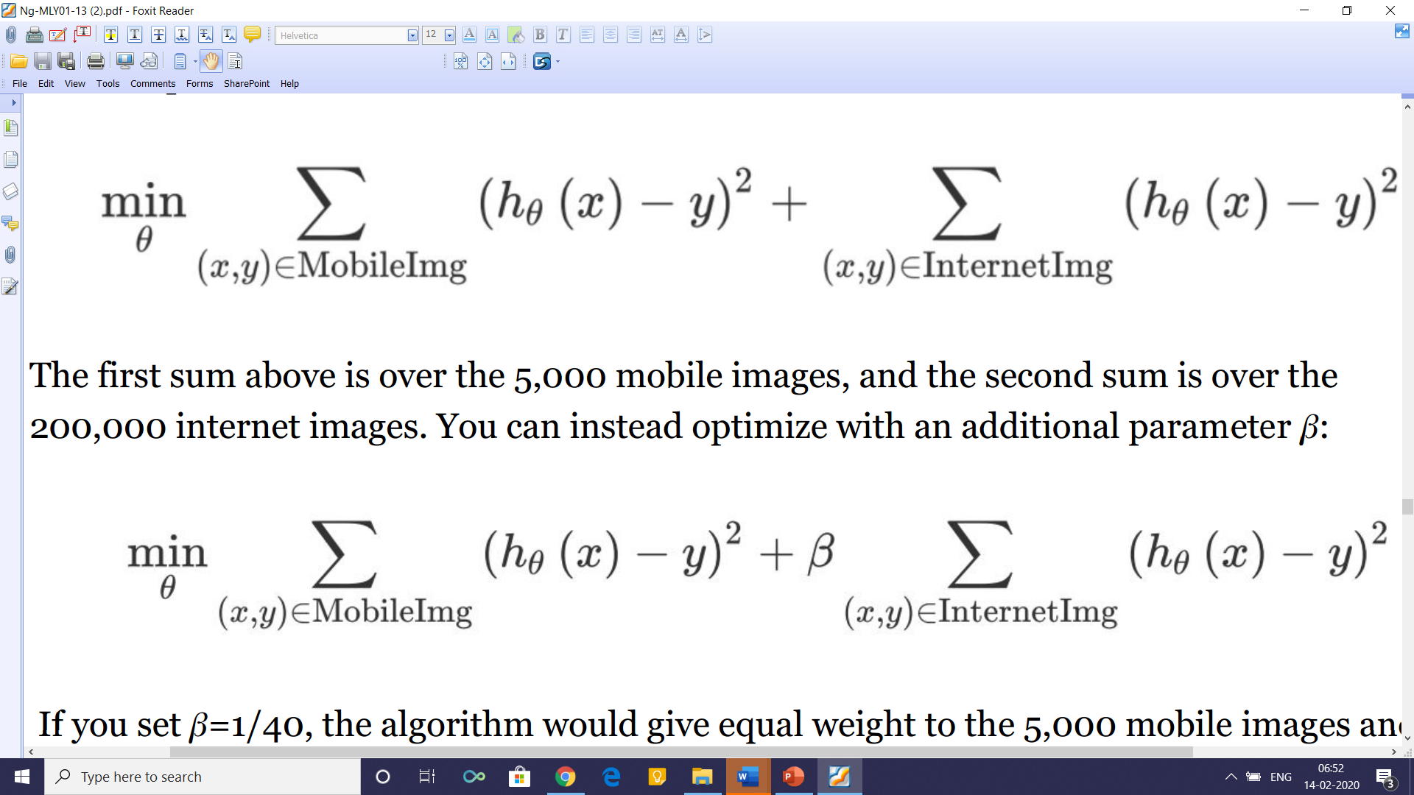
Weighting Data
Internet Images: 200,000 Mobile images: 5,000
β= ?

Slide 100
Generalizing from the training set to the dev set
Cat/N0n-cat: The algorithm has a much higher dev/test set error than you would like.
Does not do well on the training set. High (avoidable) bias on the training set distribution.
Does well on the training set, but does not generalize well to previously unseen data drawn from the same distribution as the training set​. High variance.
Generalizes well to new data drawn from the same distribution as the training set, but not to data drawn from the dev/test set distribution.
We call this problem data mismatch, since it is because the training set data is a poor match for the dev/test set data.

Slide 101
Generalizing from the training set to the dev set
Humans achieve near perfect performance on the cat recognition task.
Your algorithm achieves this:
1% error on the training set
1.5% error on data drawn from the same distribution as the training set that the algorithm has not seen
10% error on the dev set

Slide 102
Generalizing from the training set to the dev set
Humans achieve near perfect performance on the cat recognition task.
Your algorithm achieves this:
1% error on the training set
1.5% error on data drawn from the same distribution as the training set that the algorithm has not seen
10% error on the dev set
Solution: Try to make the training data more similar to the dev/test data.

Slide 103
Generalizing from the training set to the dev set
To diagnose to what extent an algorithm suffers from each of the problems 1-3
Do not give the algorithm all the available training data split it into two subsets
The actual training set which the algorithm will train on
A separate set, which we will call the “Training dev” set
Training Set and “Training dev” set have same distribution

Slide 104
Generalizing from the training set to the dev set
Training set. This is the data that the algorithm will learn from (e.g., Internet images + Mobile images). This does not have to be drawn from the same distribution as what we really care about (the dev/test set distribution).
Training dev set: This data is drawn from the same distribution as the training set (e.g., Internet images + Mobile images). This is usually smaller than the training set; it only needs to be large enough to evaluate and track the progress of our learning algorithm.
Dev set: This is drawn from the same distribution as the test set, and it reflects the distribution of data that we ultimately care about doing well on. (e.g., mobile images.)
Test set: This is drawn from the same distribution as the dev set. (e.g., mobile images.)

Slide 105
Identifying Bias, Variance, and Data Mismatch Errors
Suppose humans achieve almost perfect performance (≈0% error) on the cat detection task
Optimal error rate: about 0%.
Suppose you have:
• 1% error on the training set.
• 5% error on training dev set.
• 5% error on the dev set.

Slide 106
Identifying Bias, Variance, and Data Mismatch Errors
Suppose humans achieve almost perfect performance (≈0% error) on the cat detection task
Optimal error rate: about 0%.
Suppose you have:
• 1% error on the training set.
• 5% error on training dev set.
• 5% error on the dev set.
High Variance

Slide 107
Identifying Bias, Variance, and Data Mismatch Errors
Now, suppose your algorithm achieves:
• 10% error on the training set.
• 11% error on training dev set.
• 12% error on the dev set.

Slide 108
Identifying Bias, Variance, and Data Mismatch Errors
Suppose your algorithm achieves:
• 10% error on the training set.
• 11% error on training dev set.
• 12% error on the dev set.
High avoidable bias
Suppose your algorithm achieves:
• 10% error on the training set.
• 11% error on training dev set.
• 20% error on the dev set.

Slide 109
Identifying Bias, Variance, and Data Mismatch Errors
Suppose your algorithm achieves:
• 10% error on the training set.
• 11% error on training dev set.
• 12% error on the dev set.
High avoidable bias

Slide 110
Identifying Bias, Variance, and Data Mismatch Errors
Suppose your algorithm achieves:
• 10% error on the training set.
• 11% error on training dev set.
• 20% error on the dev set.
High avoidable bias and data mismatch
High variance?

Slide 111
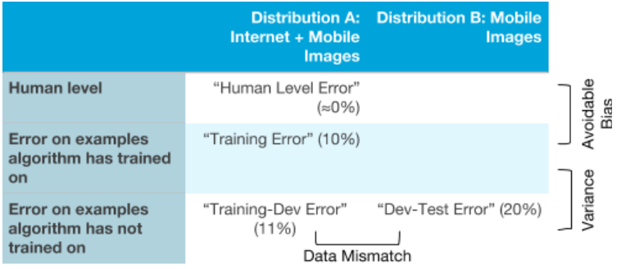
Identifying Bias, Variance, and Data Mismatch Errors

Slide 112
Addressing Data Mismatch
Situation: A speech recognition system works well on a training set as well as training dev set, but does not work well on the dev set.
Analysis: ?
Notes:
Analysis: car noise and hence Mismatched data characteristics

Slide 113
Addressing Data Mismatch
Situation: A speech recognition system works well on a training set as well as training dev set, but does not work well on the dev set.
Analysis: Manually Examine 100 samples:
Finding: most of the audio clips in the dev set are taken within a car, whereas most of the training examples were recorded against a quiet background.

Slide 114
Addressing Data Mismatch
Situation: A speech recognition system works well on a training set as well as training dev set, but does not work well on the dev set.
Analysis: Manually Examine 100 samples:
Finding: most of the audio clips in the dev set are taken within a car, whereas most of the training examples were recorded against a quiet background.
Action: Add more data having characteristics like dev set
Challenge: Such data may not be readily available
Solution: Generate artificial data

Slide 115
Artificial Data Synthesis
Already available: speech data
Collect: data of car noise
Add: noise to available speech data
Care: If we have just one hour of car noise, the algorithm may overfit. Data so generated may appear realistic to a human, but not to a machine!
Mobile (dev set) images: Blurred
Central Idea: Avoid giving the synthesized data properties that makes it possible for a learning algorithm to distinguish synthesized from non-synthesized examples

Slide 116
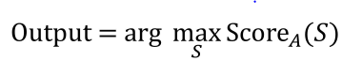
The Optimization Verification test
Problem: Convert an audio clip (say, A) to text
Evaluate: Score_{A}(S​), for each possible output sentence
Suppose English language has 50,000 words
How many sentences of length N to be evaluated?

Slide 117
The Optimization Verification test
Problem: Covert an audio clip to text
Evaluate: Score_{A}(S​), for each possible output sentence
Suppose English language has 50,000 words
How many sentences of length N to be evaluated?
Problem: Covert an audio clip to text
Evaluate: Score_{A}(S​), for each possible output sentence
Suppose English language has 50,000 words
How many sentences of length N to be evaluated?
50,000^{N} = (5X10⁴) ^{N} = 5^{N} X (10⁴)^{N} = 5^{N} X 10^{4N}
⁼ 5⁸ X 10³² = 390625 X 10³² = 3.9X 10³⁷

Slide 118
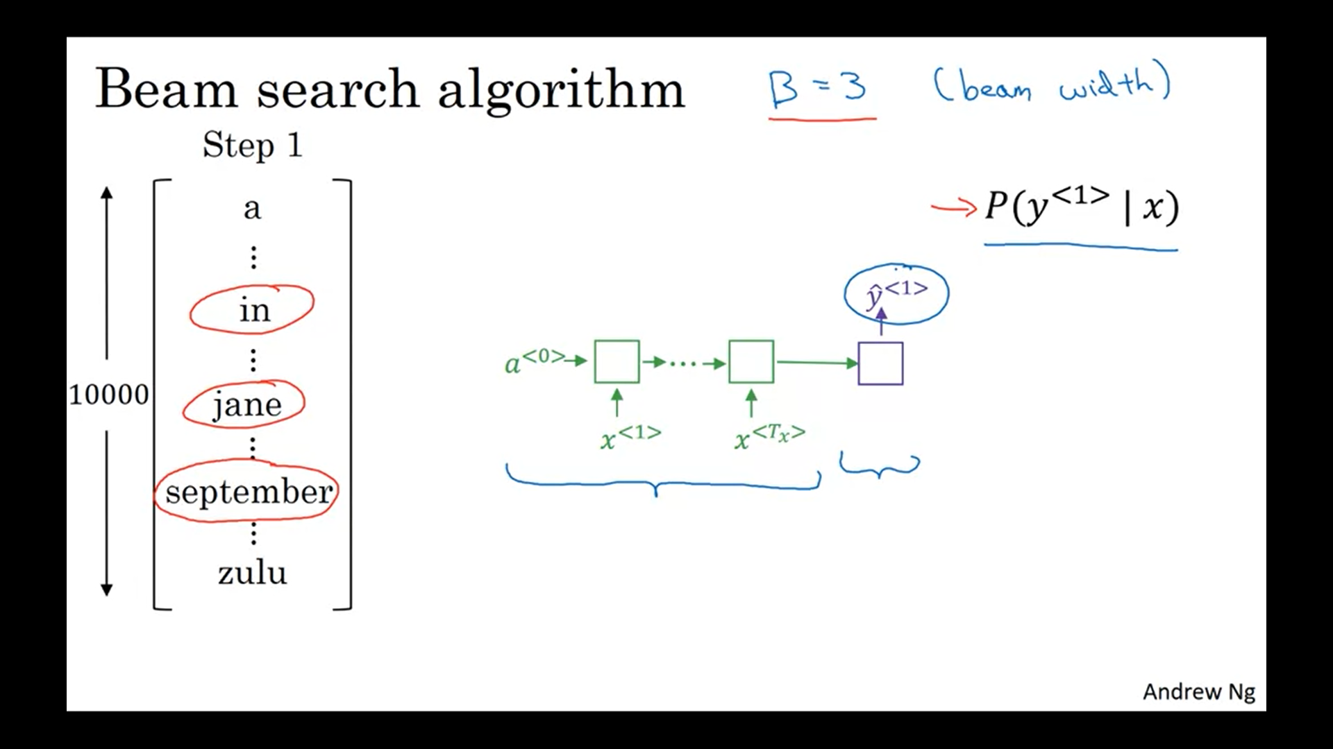
Beam search picks not just the best word, but B (width of beam search) best words

Slide 119
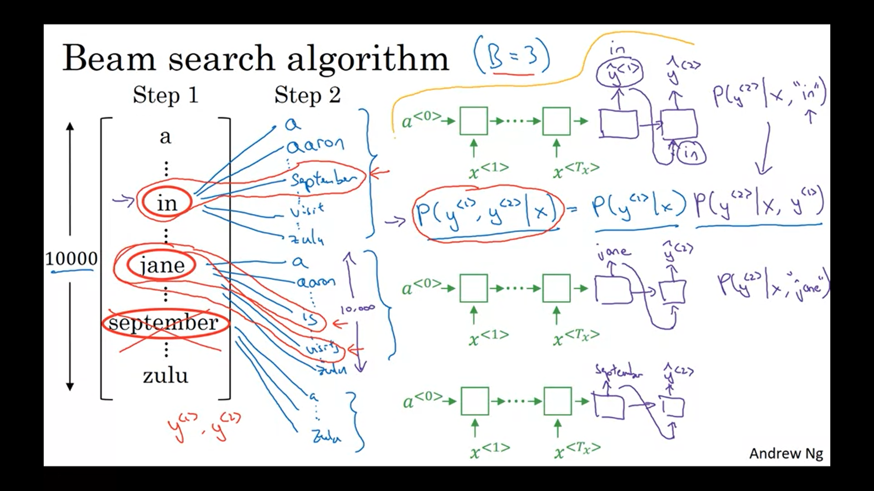
As B= 3, the algorithm finds three best words at every step.
In step 1, in, jane, and September are picked up.
In step 2, P(y^{<1>}, y^{<2>}| x) is evaluated for each of the three choices of y^{<1>} and three best matches are selected for each of three choices of y^{<1>}.
Next, out of nine y^{<1>}, y^{<2>} pairs, best three are selected.
Suppose, beam search decides that the most likely choices for the first and second words are in September, or Jane is, or Jane visits.
Then Beam search rejects September as a candidate for the first word for further search.
Thus, at every step three copies of the network are evaluated

Slide 120
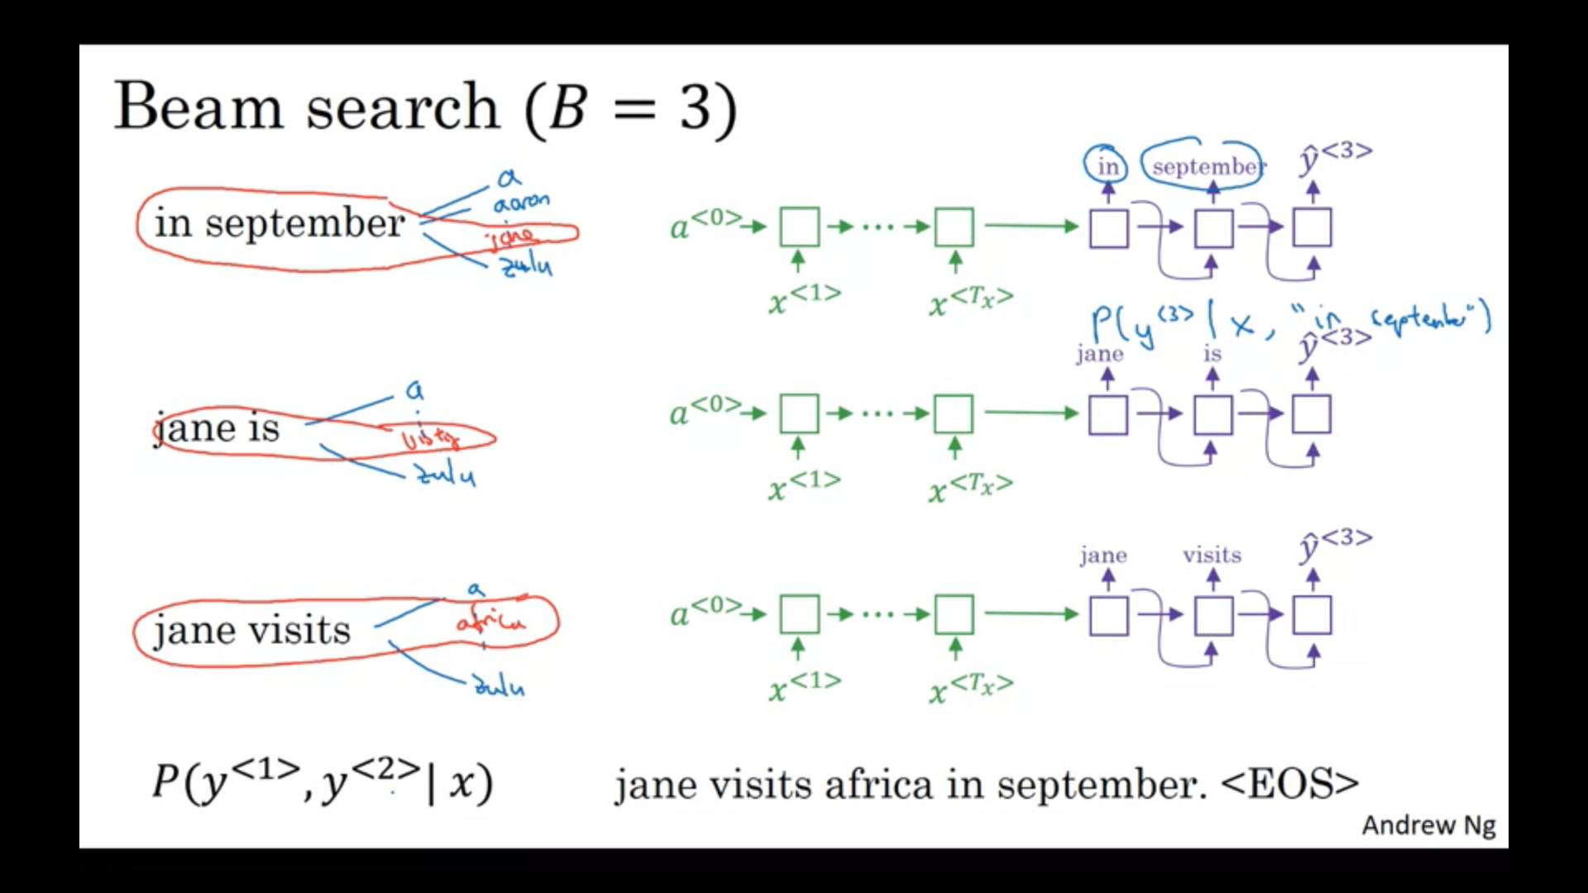
Notice that it is only by chance that Beam search has picked one word from each of the three networks.
Sentence at the bottom is likely output when Beam search is continued.

Slide 121
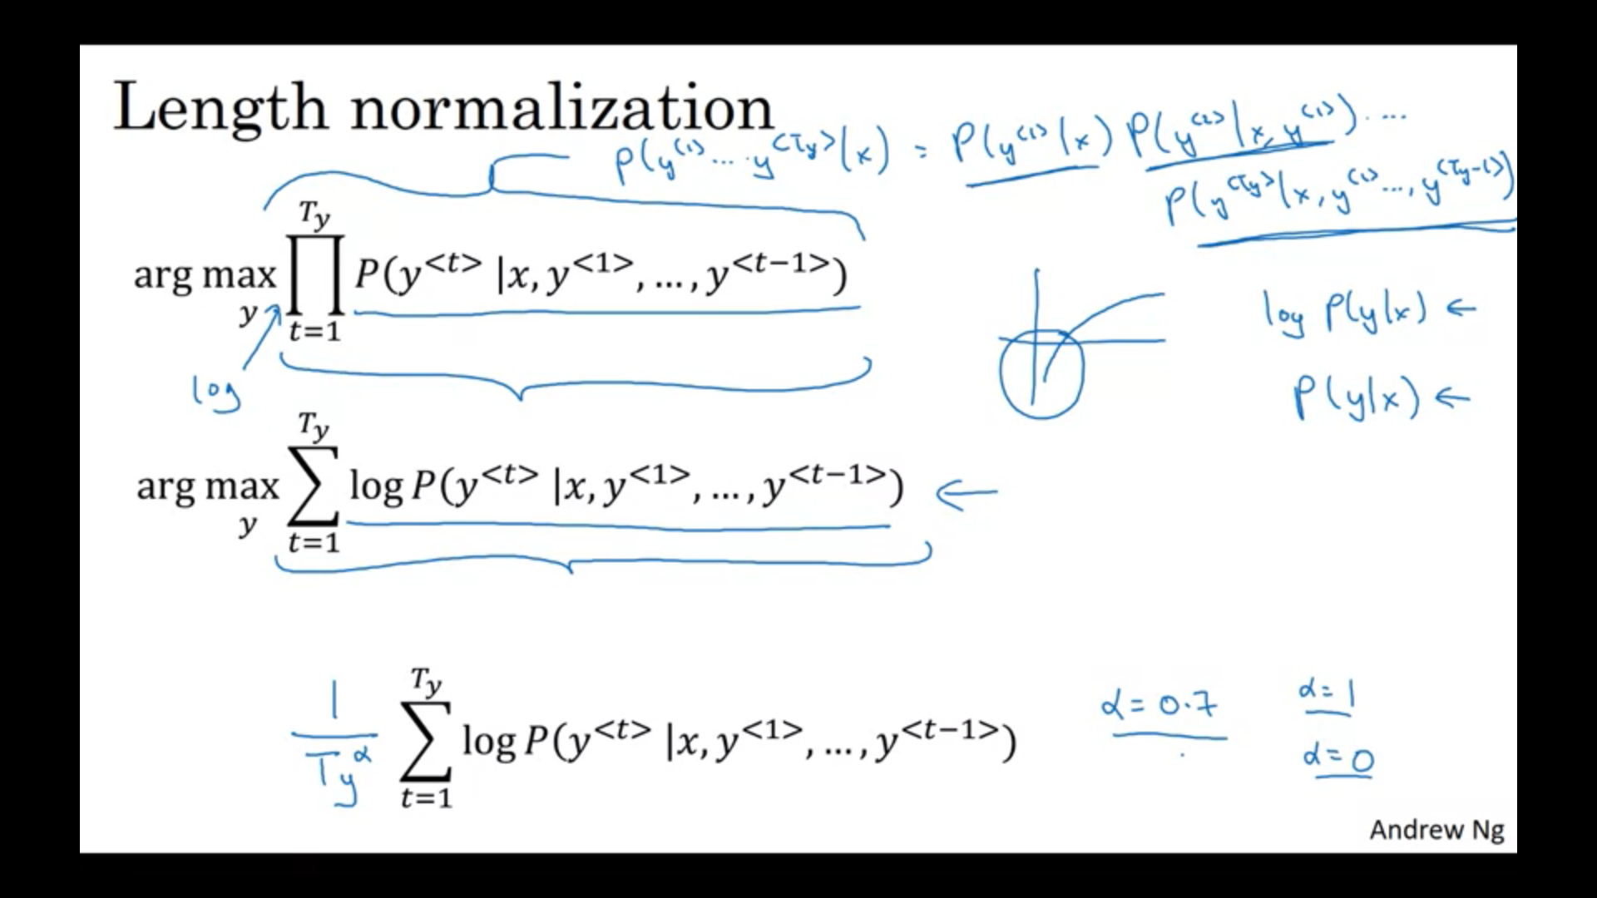
Refinements of Beam Search
As multiplying a number of small probabilities may lead to underflow, use log of the product of probabilities.
This changes product to summation
Normalize by length. In fact one uses (T_{y})^{α}where α= 0.7
How to choose B
Application dependent, but 1000 to 3000 is not uncommon

Slide 122
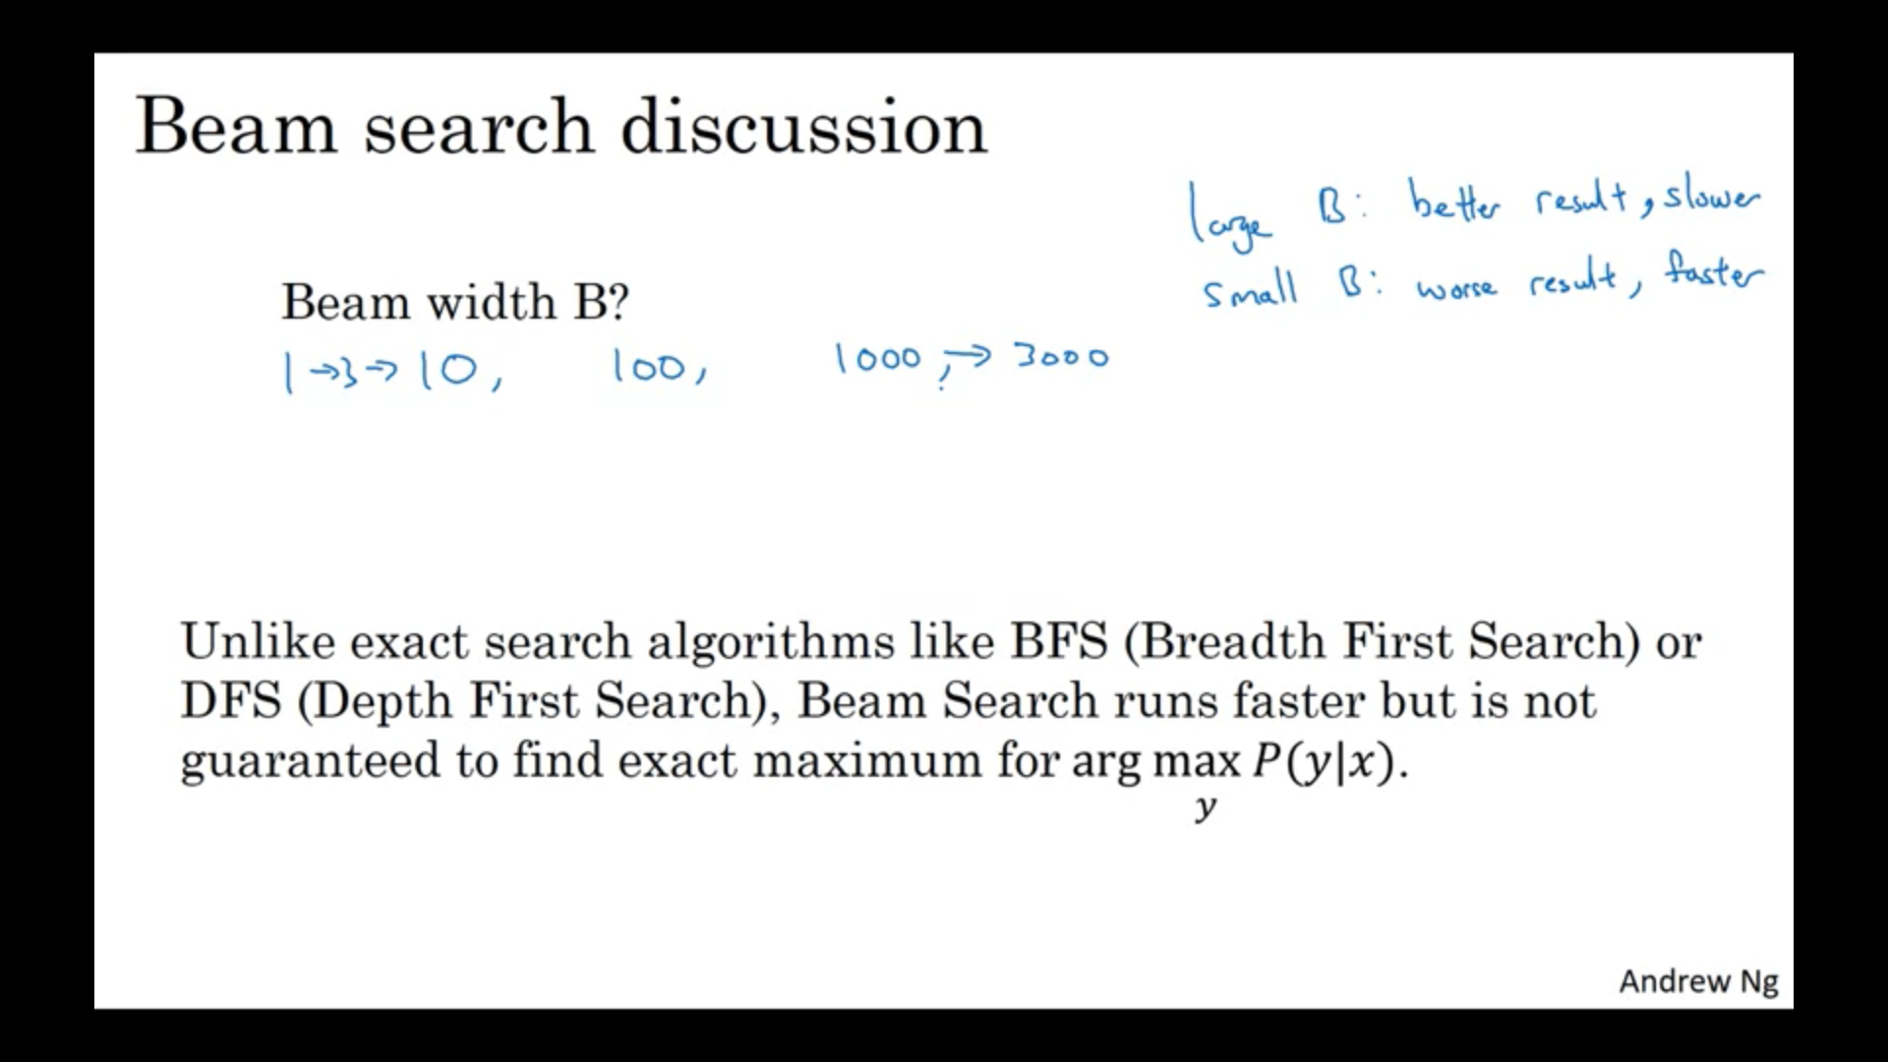

Slide 123
The Optimization Verification test: Beam Search
Original Sentence (S*): “I love machine learning”
Output Sentence (S_{out}): “I love robots”
Score_{A}(S*) > Score_{A}(S_{out}) ?
Case 1: Score_{A}(S*) > Score_{A}(S_{out})
Scoring algorithm has correctly rated S*, S_{out}
Culprit: Beam Search
Case 2: Score_{A}(S*) <= Score_{A}(S_{out})
Culprit: Scoring algorithm

Slide 124
The Optimization Verification test: Beam Search
In practice,
Beam search may be at fault for some sentences
Scoring function may be at fault for some other sentences
Example:
95% of the errors due to the scoring function
5% due to search optimization algorithm.

Slide 125
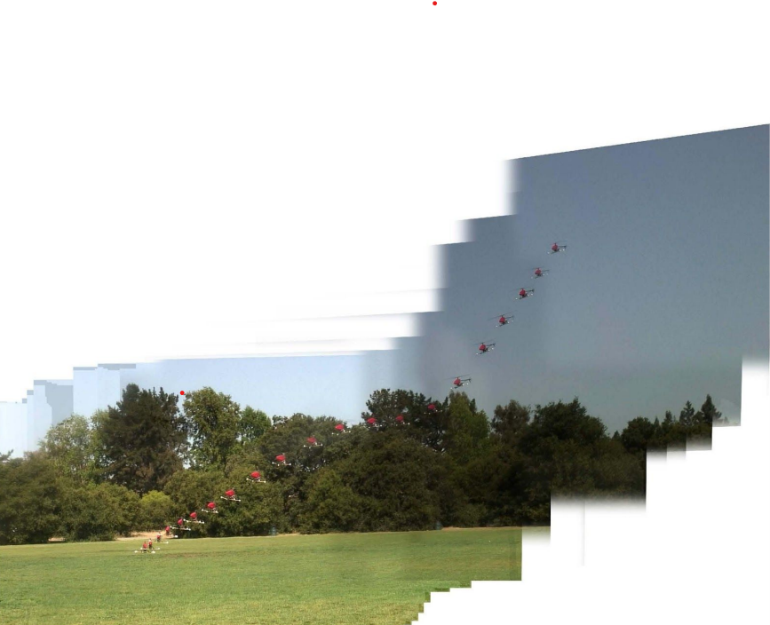
Reinforcement learning example Find trajectory (T) for safe landing

Slide 126
Reinforcement learning example Find trajectory (T) for safe landing
R(T_{human}) > R(T_{out}) ?
Case 1: R(T_{human}) > R(T_{out})
Reward function R​(.) is correctly rating T​_{human} as superior to T​_{out}
Reinforcement learning algorithm is finding the inferior T​_{out}
Case 2: R(T_{human}) <= R(T_{out})
R​(.) assigns a worse score to T​_{human} even though it is the superior trajectory.
We should work on improving R​(.) to better capture the tradeoffs that correspond to a good landing.

Slide 127
Audio clip transcription vs helicopter landing
Audio clip transcription: Comparing with well defined optimal performance
helicopter landing: Comparing with human performance
In general, so long as you have some y* (in this example, T_{human}) that is a superior output to the performance of your current learning algorithm —even if it is not the “optimal” output—then the Optimization Verification test can indicate whether it is more promising to improve the optimization algorithm or the scoring function.

Slide 128
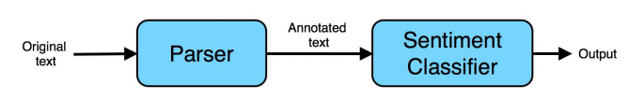
Sentiment classifier: traditional approach
Sentiment classification: a system (classifier) to examine online product reviews and automatically tell you if the writer liked or disliked that product.
positive: This is a great mop!
negative: This mop is low quality--I regret buying it.
Solution: Build a pipeline of two components

Slide 129
Sentiment classifier: traditional approach
Parser: Annotates the text with information identifying the most important words. For example, use the parser to label all the nouns and adjectives.
This is a great_{Adjective} mop_{Noun}!
Sentiment classifier: A learning algorithm that takes as input the annotated text and predicts the overall sentiment.
The parser’s annotation could help the learning algorithm greatly: By giving adjectives a higher weight, your algorithm will be able to quickly hone in on the important words such as “great,” and ignore less important words such as “this.”

Slide 130
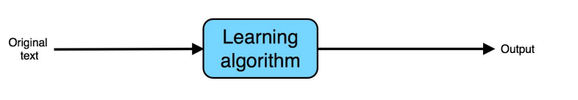
Sentiment classifier: An end-to-end learning algorithm
End-to-end learning: go directly from the input to the desired output
Typically deploy large neural networks
Require abundant data

Slide 131
Speech recognition system
Compute features: Extract hand-designed features, such as MFCC (Mel-frequency cepstrum coefficients) features, which try to capture the content of an utterance while disregarding less relevant properties, such as the speaker’s pitch.
Phoneme recognizer: Some linguists believe that there are basic units of sound called “phonemes.” For example, the initial “k” sound in “keep” is the same phoneme as the “c” sound in “cake.” This system tries to recognize the phonemes in the audio clip.
Final recognizer: Take the sequence of recognized phonemes, and try to string them together into an output transcript.
End to end learning:

Slide 132
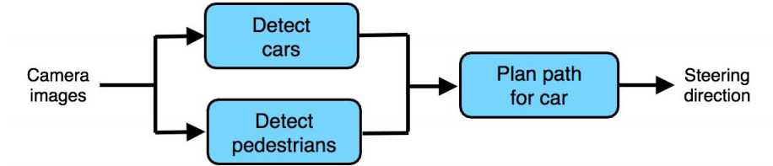
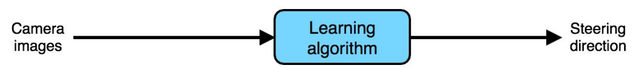
Non-linear ML pipeline
Traditional approach:
End-to-end approach:

Slide 133
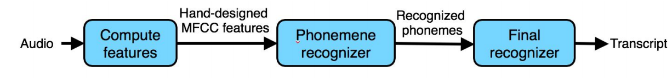
Pros and cons of end-to-end learning
MFCCs : A set of hand-designed audio features.
they provide a reasonable summary of the audio input,
they also simplify the input signal by throwing some information away.
Phonemes: An invention of linguists.
an imperfect representation of speech sounds.
a poor approximation of reality,
forcing an algorithm to use a phoneme representation will limit the speech system’s performance.

Slide 134
Allowing hand-engineered components: Advantages
MFCC features are robust to some properties of speech that do not affect the content,
thus, they help simplify the problem for the learning algorithm.
examples: speaker pitch.
To the extent that phonemes are a reasonable representation of speech, they can also help the learning algorithm understand basic sound components and therefore improve its performance.
Having more hand-engineered components generally allows a speech system to learn with less data.
The hand-engineered knowledge captured by MFCCs and phonemes “supplements” the knowledge our algorithm acquires from data.
When we don’t have much data, this knowledge is useful.

Slide 135
End-to-end system
This system lacks the hand-engineered knowledge.
When the training set is small,
it might do worse than the hand-engineered pipeline.
When the training set is large,
it is not hampered by the limitations of an MFCC or phoneme-based representation.

Slide 136
End-to-end system
This system lacks the hand-engineered knowledge.
When the training set is small, it might do worse than the hand-engineered pipeline.
When the training set is large,
it is not hampered by the limitations of an MFCC or phoneme-based representation.
If the learning algorithm is a large-enough neural network and if it is trained with enough training data, it has the potential to do very well, and perhaps even approach the optimal error rate.

Slide 137
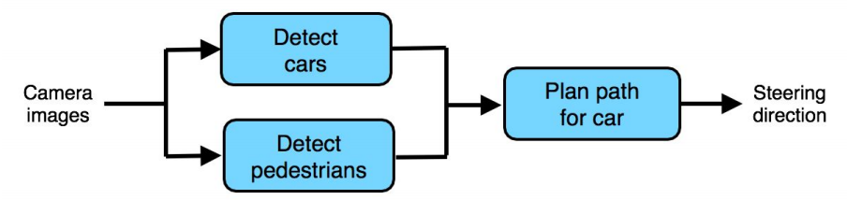
Choosing pipeline components: Data availability
An autonomous driving architecture
Use machine learning to detect cars and pedestrians.
it is not hard to obtain data for these
numerous computer vision datasets with large numbers of labeled cars and pedestrians.
use crowdsourcing (such as Amazon Mechanical Turk) to obtain even larger datasets.
It is thus relatively easy to obtain training data to build a car detector and a pedestrian detector.

Slide 138
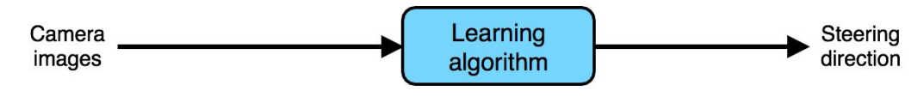
A pure end-to-end approach
Need a large dataset of (Image, Steering Direction) pairs
very time-consuming and expensive to have people drive cars around and record their steering direction to collect such data.
need a fleet of specially-instrumented cars, and a huge amount of driving to cover a wide range of possible scenarios.

Slide 139
Pipeline vs end-to-end approach
A lot of data available for training “intermediate modules” of a pipeline (such as a car detector or a pedestrian detector)
consider using a pipeline with multiple stages

Slide 140


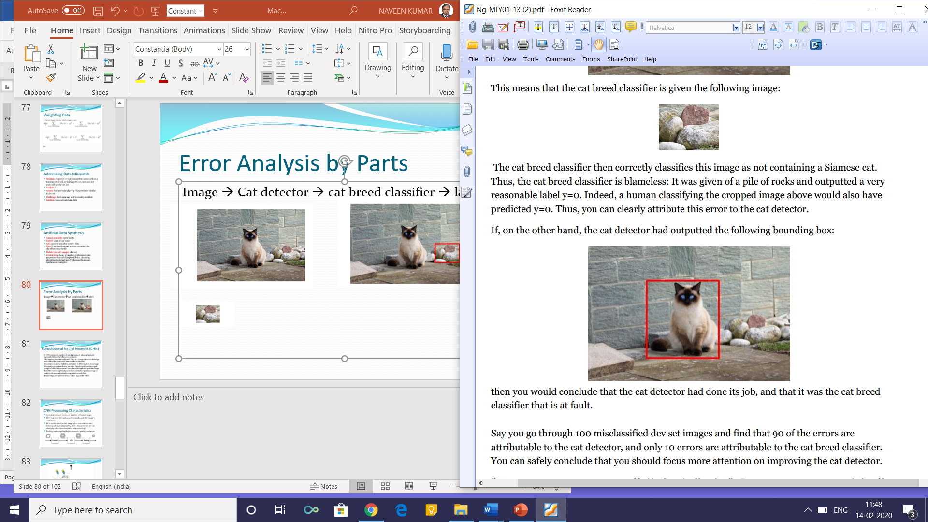
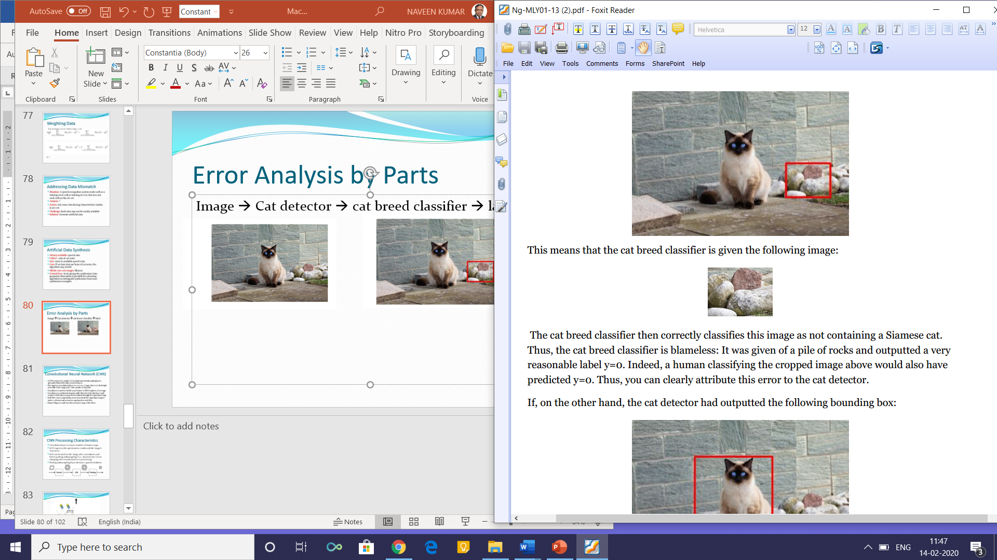
Error Analysis by Parts
Image → Cat detector → cat breed classifier → label 0/1
Notes:
Siamese cat labelled 0

Slide 141
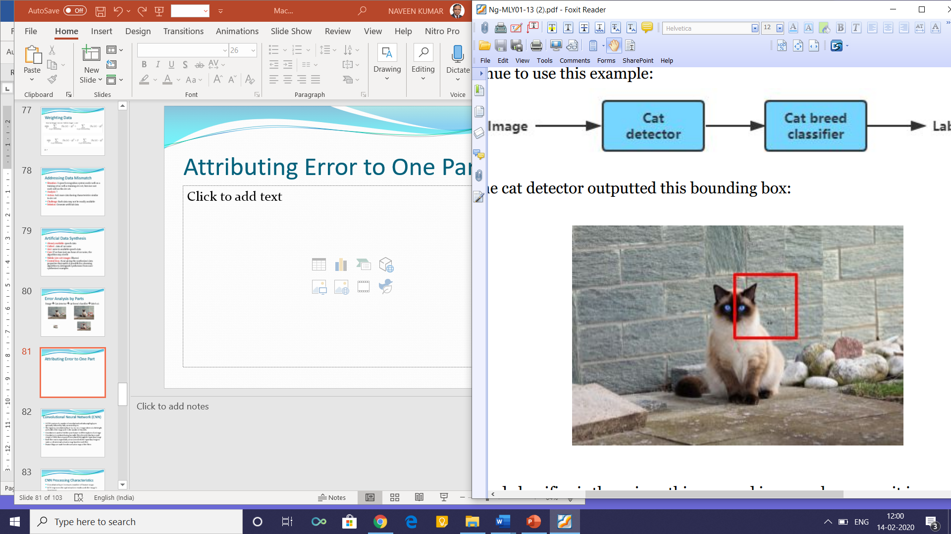

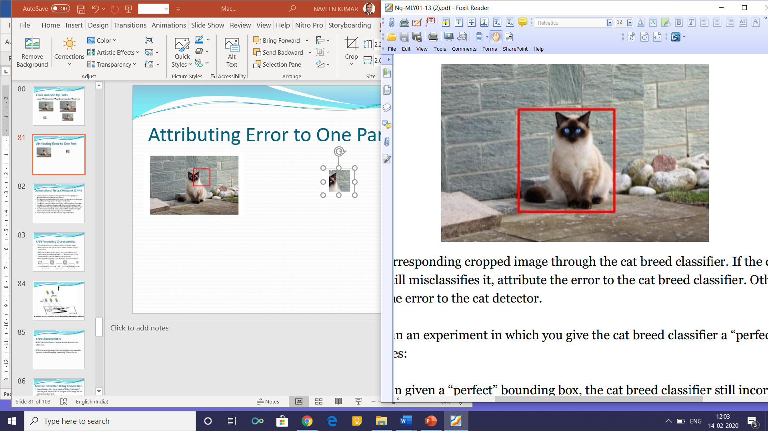
Attributing Error to One Part
Replace the detector with a hand made bounding box
Run the classifier again

Slide 142

General Case of Error Attribution
A → B → C→ output
FF
DAG ordering of the steps in ML pipeline
Informal Analysis
How far is the performance of each component from human-level

Slide 143

Spotting a Flawed ML Pipeline

Slide 144
Convolutional Neural Network (CNN)
A CNN consists of a number of convolutional and subsampling layers optionally followed by fully connected layers.
The input to a convolutional layer is a m x m x r image where m is the height and width of the image and r is the number of channels.
Convolution is used to find the same feature in different places of an image
Convolution is conducted using learnable filters/kernels (that have small receptive fields) that are passed (convoluted) through the input data/image
Each filter moves sequentially across (convolved) the input data/image to make a 2-dimensional activation map based on each filter
Feature Maps are made from the activation maps of the filters

Slide 145

CNN Processing Characteristics
Convolution layer increases number of feature maps
LCN improves the optimization results and the image’s invariance
LCN can be used on the image after convolution and before pooling (subsampling) (i.e., characteristic of not changing after transformation or processing)
Pooling (subsampling) layer deceases spatial resolution

Slide 146

A full layer in a CNN consisting of convolutional and subsampling sublayers
Notes:
First layer of a convolutional neural network with pooling. Units of the same color have tied weights and units of different color represent different filter maps.

Slide 147
CNN Characteristics
ReLU (Rectified Linear Units) activation functions are often used
CNNs are used in image/video recognition, recommender systems, natural language processing, Chess, Go, etc.

Slide 148
Feature Extraction Using Convolution
Natural images have the property of being ”‘stationary”’, meaning that the statistics of one part of the image are the same as any other part.
This suggests that the features that we learn at one part of the image can also be applied to other parts of the image, and we can use the same features at all locations.
More precisely, having learned features over small (say 8x8) patches sampled randomly from the larger image, we can then apply this learned 8x8 feature detector anywhere in the image

Slide 149
Example
To give a concrete example, suppose you have learned features on 8x8 patches sampled from a 96x96 image.
Suppose further this was done with an auto-encoder that has 100 hidden units.
To get the convolved features, for every 8x8 region of the 96x96 image, that is, the 8x8 regions starting at (1,1),(1,2),…(89,89) (1,1),(1,2),…(89,89), you would extract the 8x8 patch, and run it through your trained sparse auto-encoder to get the feature activations.
This would result in 100 sets 89x89 convolved features.

Slide 150


Slide 151
RNN (Recurrent Neural Network)
It is a Neural Network that uses directed cyclic connections between neurons.
Directed cyclic connections create internal states with dynamic temporal characteristics
Internal memory is used to process arbitrary input data sequences
Sequence Modeling is used for data sequence Classification & Clustering
Sequence Modeling structure based on S2S (Sequence to Sequence) Learning
N inputs are transformed into M outputs

Slide 152


Forward and Backward RNN
Forward RNN
Backward RNN
Notes:
Forward RNN: RNN layer works in the same direction as that of data inputs in the input layer.
Backward RNN: RNN layer operates in the sequence direction that is opposite to the forward RNN.

Slide 153

Project 1:Classification of two sets of clusters of data

Slide 154


Slide 155
Project 2
Classification of two Data sets
Orange data surrounds the blue data in a circular shape

Slide 156

Classification fails !!
Output results of Test Loss 0.419 and Training Loss 0.380 show that the classification has failed

Slide 157

One line is not sufficient as a solution -Multiple neurons in the hidden layer are needed
With two neurons, the performance improves
Test Loss 0.419 -> 0.228
Training Loss 0.380 -> 0.220
But still the classification fails

Slide 158

With three neurons, the performance improves
Test Loss 0.419 -> 0.228 -> 0.005
Training Loss 0.380 -> 0.220 -> 0.004
Classification succeeds

Slide 159

Project 3

Slide 160
Project 4
Classify swirled structure of orange and blue data

Slide 161

Classification fails even if we add number of neurons. Thus, now we will have to add hidden layers.

Slide 162


Slide 163


Slide 164


Slide 165


Slide 167


Slide 168

Comparing Convergence: Batch Sizes

Slide 169
Identifying Bias, Variance, and Data Mismatch Errors
Consider filling up the remaining two boxes in the table
Ask a person to examine samples from dev-test set
Include part of dev-test data in the training set

Slide 171
The Optimization Verification test: Beam Search (Width = 3)
Slots: 1 w₁₃ 2 3 4 5 6 7 8 (N= 8)
Slot 1: w₁₁ , w₁₂, w₁₃: Most likely to begin the sentence
Slot 2: (Based on step 2 output w₁₁ , w₁₂, w₁₃) 150,000 candidates
w₁₁: P(x₁|w₁₁) … P(x_{50,00}|w₁₁): w₁₁ x₂₃₆₉
w₁₂: P(x₁|w₁₂) … P(x_{50,00}|w₁₂): w₁₂x₂₅₆₉₄ w₁₂x₃₅₆₉₄
w₁₃: P(x₁|w₁₃) … P(x_{50,00}|w₁₃): w₁₃x₄₃₆₆₉
Step3 (Based on step 2 output w₂₁ , w₂₂, w₂₃)
w₁₁: P(x₁|w₂₁) … P(x_{50,00}|w₂₁)
w₁₂: P(x₁|w₂₂) … P(x_{50,00}|w₂₂)
w₁₃: P(x₁|w₃₃) … P(x_{50,00}|w₃₃)
Output: w₃₁ , w₃₂, w₃₃

Slide 172
Mobile App: Cat vs Non-Cat
Observation: 90% accuracy, app mistakes dogs for cats
What to do?
Get a sample of 100 misclassified dev examples
Count what fraction of these are dogs
Finding: 5% of misclassified images are dogs
Q: Do we incorporate a tool that works well on dogs
Best expected?
All misclassified dogs marked Non-cat
On a sample of 100, there are 10 errors
Out of all errors, 5% are dogs classified as cats
Improvement: 5% of 10 i.e. 0.5, Accuracy moves up 90% to 90.5%

Slide 173
Mobile App: Cat vs Non-Cat
Observation: 90% accuracy, app mistakes dogs for cats
What to do?
Get a sample of 100 misclassified dev examples
Count what fraction of these are dogs
Finding: 50% of misclassified images are dogs
Best expected?

Slide 174
Mobile App: Cat vs Non-Cat
Observation: 90% accuracy, app mistakes dogs for cats
What to do?
Get a sample of 100 misclassified dev examples
Count what fraction of these are dogs
Finding: 50% of misclassified images are dogs
Best expected? 50% of 10 is 5
Accuracy moves up from 90 % to 95%

Slide 175
Effect of adding more data
Adding more training data: Training error can only get worse. It can only get further away from the (green line) level of desired performance
The red dev error curve is usually higher than the blue training error. So, Thus, there’s almost no way that adding more data would allow the red dev error curve to drop down to the desired level of performance when even the training error is higher than the desired level of performance

